Slide 1
Disclaimer: These slides are copyrighted and strictly for personal use only
NOT FOR DISTRIBUTION © Stephane Maarek www.datacumulus.com
This document is reserved for people enrolled into the Ultimate AWS Solutions Architect Associate Course
Please do not share this document, it is intended for personal use and exam preparation only, thank you.
If you’ve obtained these slides for free on a website that is not the course’s website, please reach out to piracy@datacumulus.com.Thanks!
Best of luck for the exam and happy learning!
© Stephane Maarek

Slide 2
AWS Certified Solutions Architect Associate Course
SAA-C01
NOT FOR DISTRIBUTION © Stephane Maarek www.datacumulus.com
© Stephane Maarek

Slide 3

Welcome! We’re starting in 5 minutes
NOT FOR DISTRIBUTION © Stephane Maarek www.datacumulus.com
We’re going to prepare for the Solutions Architect exam - SAA-C01
It’s a challenging certification, so this course will be long and interesting
Basic IT knowledge is necessary
This course contains videos…
From the Developer and SysOps course - shared knowledge
Specific to the Solutions Architect exam - exciting ones on architecture!
We will cover over 30 AWS services
AWS / IT Beginners welcome! (but take your time, it’s not a race)
© Stephane Maarek

Slide 4
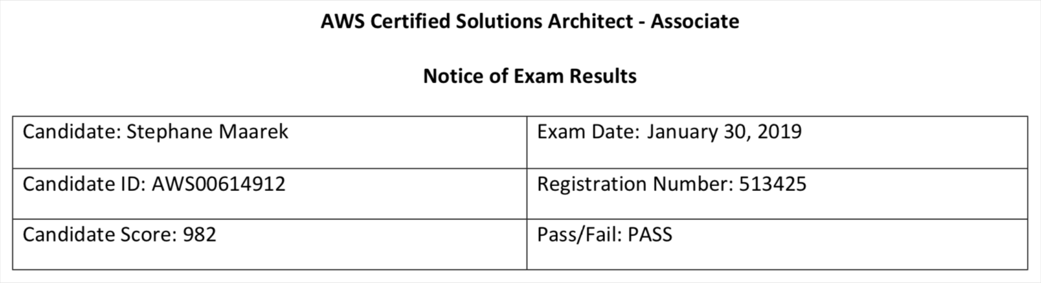
My certification: 98.2%
NOT FOR DISTRIBUTION © Stephane Maarek www.datacumulus.com
© Stephane Maarek

Slide 5

About me
NOT FOR DISTRIBUTION © Stephane Maarek www.datacumulus.com
I’m Stephane!
Working as in IT consultant and AWS Solutions Architect, Developer & SysOps
Worked with AWS many years: built websites, apps, streaming platforms
Veteran Instructor on AWS (Certifications, CloudFormation, Lambda, EC2…)
You can find me on
GitHub: https://github.com/simplesteph
LinkedIn: https://www.linkedin.com/in/stephanemaarek
Medium: https://medium.com/@stephane.maarek
Twitter: https://twitter.com/stephanemaarek
© Stephane Maarek

Slide 6

What’s AWS?
NOT FOR DISTRIBUTION © Stephane Maarek www.datacumulus.com
AWS (Amazon Web Services) is a Cloud Provider
They provide you with servers and services that you can use on demand and scale easily
AWS has revolutionized IT over time
AWS powers some of the biggest websites in the world
Amazon.com
Netflix
© Stephane Maarek

Slide 7


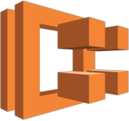



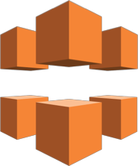
























What we’ll learn in this course (and more!)
NOT FOR DISTRIBUTION © Stephane Maarek www.datacumulus.com
Amazon EC2 | Amazon ECR | Amazon ECS | AWS Elastic | AWS | Elastic Load | Amazon | Amazon | Amazon | Amazon
 |  |  | Beanstalk | Lambda | Balancing | CloudFront | Kinesis | Route 53 | S3
Amazon RDS
Amazon DynamoDB
Amazon DynamoDB Accelerator
Amazon ElastiCache
Amazon SQS
Amazon SNS
AWS Step Functions
Amazon SWF
Amazon API Gateway
Amazon SES
Amazon Cognito
IAM
Amazon CloudWatch
Amazon EC2 Systems Manager
AWS
CloudFormation
AWS
CloudTrail
AWS
CodeCommit
AWS
CodeBuild
AWS
CodeDeploy
AWS
CodePipeline
AWS KMS
© Stephane Maarek

Slide 8

Navigating the AWS spaghetti bowl
NOT FOR DISTRIBUTION © Stephane Maarek www.datacumulus.com
© Stephane Maarek

Slide 9
Udemy Tips
NOT FOR DISTRIBUTION © Stephane Maarek www.datacumulus.com
© Stephane Maarek

Slide 10
NOT FOR DISTRIBUTION © Stephane Maarek www.datacumulus.com
AWS Fundamentals – Part I
Regions, IAM & EC2
© Stephane Maarek

Slide 11
AWS Regions
NOT FOR DISTRIBUTION © Stephane Maarek www.datacumulus.com
AWS has regions all around the world (us-east-1)
Each region has availability zones (us- east-1a, us-east-1b…)
Each availability zone is a physical data center in the region, but separate from the other ones (so that they’re isolated from disasters)
AWS Consoles are region scoped (except IAM, S3 & Route53)
AWS Region (Sydney: ap-southeast-2)
ap-southeast-2a
ap-southeast-2b
ap-southeast-2c
© Stephane Maarek

Slide 12
IAM Introduction
NOT FOR DISTRIBUTION © Stephane Maarek www.datacumulus.com
IAM (Identity and Access Management)
Your whole AWS security is there:
Users
Groups
Roles
Root account should never be used (and shared)
Users must be created with proper permissions
IAM is at the center of AWS
Policies are written in JSON (JavaScript Object Notation)
© Stephane Maarek

Slide 13
IAM Introduction
NOT FOR DISTRIBUTION © Stephane Maarek www.datacumulus.com
Users
Usually a physical person
Groups
Functions (admins, devops)
Teams (engineering, design…)
Contains users!
Roles
Internal usage within AWS resources
Policies (JSON Documents)
Defines what each of the above can and cannot do
© Stephane Maarek

Slide 14
IAM Introduction
NOT FOR DISTRIBUTION © Stephane Maarek www.datacumulus.com
IAM has a global view
Permissions are governed by Policies (JSON)
MFA (Multi Factor Authentication) can be setup
IAM has predefined “managed policies”
We’ll see IAM policies in details in the future
It’s best to give users the minimal amount of permissions they need to perform their job (least privilege principles)
© Stephane Maarek

Slide 15
IAM Federation
NOT FOR DISTRIBUTION © Stephane Maarek www.datacumulus.com
Big enterprises usually integrate their own repository of users with IAM
This way, one can login into AWS using their company credentials
Identity Federation uses the SAML standard (Active Directory)
© Stephane Maarek

Slide 16
IAM 101 Brain Dump
NOT FOR DISTRIBUTION © Stephane Maarek www.datacumulus.com
One IAM User per PHYSICAL PERSON
One IAM Role per Application
IAM credentials should NEVER BE SHARED
Never, ever, ever, ever, write IAM credentials in code. EVER.
And even less, NEVER EVER EVER COMMIT YOUR IAM credentials
Never use the ROOT account except for initial setup.
Never use ROOT IAM Credentials
© Stephane Maarek

Slide 17
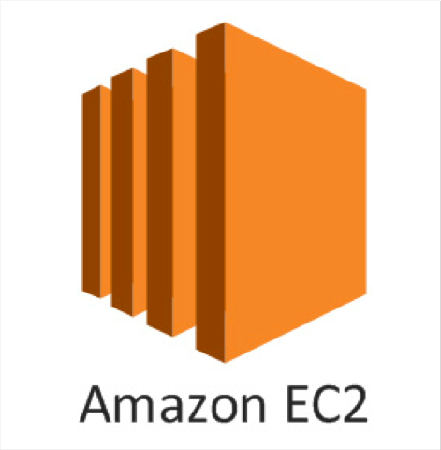
What is EC2?
NOT FOR DISTRIBUTION © Stephane Maarek www.datacumulus.com
EC2 is one of most popular of AWS offering
It mainly consists in the capability of :
Renting virtual machines (EC2)
Storing data on virtual drives (EBS)
Distributing load across machines (ELB)
Scaling the services using an auto-scaling group (ASG)
Knowing EC2 is fundamental to understand how the Cloud works
© Stephane Maarek

Slide 18
Hands-On:
Launching an EC2 Instance running Linux
NOT FOR DISTRIBUTION © Stephane Maarek www.datacumulus.com
We’ll be launching our first virtual server using the AWS Console
We’ll get a first high level approach to the various parameters
We’ll learn how to start / stop / terminate our instance.
© Stephane Maarek

Slide 19

How to SSH into your EC2 Instance Linux / Mac OS X
NOT FOR DISTRIBUTION © Stephane Maarek www.datacumulus.com
We’ll learn how to SSH into your EC2 instance using Linux / Mac
SSH is one of the most important function. It allows you to control a remote machine, all using the command line.
EC2 Machine Linux
Public IP
SSH – Port 22
WWW
We will see how we can configure OpenSSH ~/.ssh/config to facilitate the SSH into our EC2 instances
© Stephane Maarek

Slide 20

How to SSH into your EC2 Instance Windows
NOT FOR DISTRIBUTION © Stephane Maarek www.datacumulus.com
We’ll learn how to SSH into your EC2 instance using Windows
SSH is one of the most important function. It allows you to control a remote machine, all using the command line.
EC2 Machine Linux
Public IP
SSH – Port 22
WWW
We will configure all the required parameters necessary for doing SSH on Windows using the free tool Putty.
© Stephane Maarek

Slide 21
Introduction to Security Groups
NOT FOR DISTRIBUTION © Stephane Maarek www.datacumulus.com
Security Groups are the fundamental of network security in AWS
They control how traffic is allowed into or out of our EC2 Machines.
Inbound traffic Outbound traffic
Security Group
EC2 Machine
WWW
It is the most fundamental skill to learn to troubleshoot networking issues
In this lecture, we’ll learn how to use them to allow, inbound and outbound ports
© Stephane Maarek

Slide 22
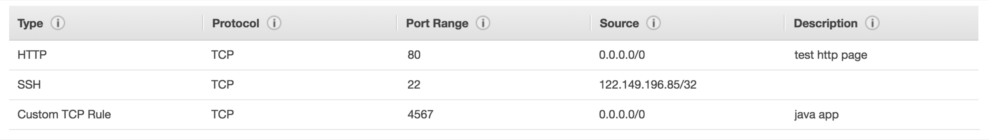
Security Groups Deeper Dive
NOT FOR DISTRIBUTION © Stephane Maarek www.datacumulus.com
Security groups are acting as a “firewall” on EC2 instances
They regulate:
Access to Ports
Authorised IP ranges – IPv4 and IPv6
Control of inbound network (from other to the instance)
Control of outbound network (from the instance to other)
© Stephane Maarek

Slide 23
Security Groups Diagram
NOT FOR DISTRIBUTION © Stephane Maarek www.datacumulus.com
Your Computer - IP XX.XX.XX.XX (authorised port 22)
Security Group 1 Inbound
Filter IP / Port with Rules
Port 22
Port 22
Other computer (not authorised port 22)
EC2 Instance IP XX.XX.XX.XX
Security Group 1 Outbound
Filter IP / Port with Rules
WWW
Any IP – Any Port
Any Port
© Stephane Maarek

Slide 24
Security Groups Good to know
NOT FOR DISTRIBUTION © Stephane Maarek www.datacumulus.com
Can be attached to multiple instances
Locked down to a region / VPC combination
Does live “outside” the EC2 – if traffic is blocked the EC2 instance won’t see it
It’s good to maintain one separate security group for SSH access
If your application is not accessible (time out), then it’s a security group issue
If your application gives a “connection refused“ error, then it’s an application error or it’s not launched
All inbound traffic is blocked by default
All outbound traffic is authorised by default
© Stephane Maarek

Slide 25
Referencing other security groups Diagram
NOT FOR DISTRIBUTION © Stephane Maarek www.datacumulus.com
Security Group 2 (attached) |  | EC2 Instance IP XX.XX.XX.XX
Port 123
Security Group 1 Inbound
Authorising Security Group 1 Authorising Security Group 2
Security Group 1 (attached) |  | EC2 Instance IP XX.XX.XX.XX
EC2 Instance IP XX.XX.XX.XX
Port 123
Security Group 3 (attached)
Port 123
EC2 Instance IP XX.XX.XX.XX
© Stephane Maarek

Slide 26
Private vs Public IP (IPv4)
NOT FOR DISTRIBUTION © Stephane Maarek www.datacumulus.com
Networking has two sorts of IPs. IPv4 and IPv6:
IPv4: 1.160.10.240
IPv6: 3ffe: 1900:4545:3:200:f8ff:fe21:67cf
In this course, we will only be using IPv4.
IPv4 is still the most common format used online.
IPv6 is newer and solves problems for the Internet of Things (IoT).
IPv4 allows for 3.7 billion different addresses in the public space
IPv4: [0-255].[0-255].[0-255].[0-255].
© Stephane Maarek

Slide 27










Private vs Public IP (IPv4) Example
NOT FOR DISTRIBUTION © Stephane Maarek www.datacumulus.com
Web Server (public): 79.216.59.75
Server (public): 211.139.37.43
WWW
Internet Gateway (public): 149.140.72.10
Internet Gateway (public): 253.144.139.205
Company A Private Network 192.168.0.1/22
Company B Private Network 192.168.0.1/22
© Stephane Maarek

Slide 28
Private vs Public IP (IPv4) Fundamental Differences
NOT FOR DISTRIBUTION © Stephane Maarek www.datacumulus.com
Public IP:
Public IP means the machine can be identified on the internet (WWW)
Must be unique across the whole web (not two machines can have the same public IP).
Can be geo-located easily
Private IP:
Private IP means the machine can only be identified on a private network only
The IP must be unique across the private network
BUT two different private networks (two companies) can have the same IPs.
Machines connect to WWW using an internet gateway (a proxy)
Only a specified range of IPs can be used as private IP
© Stephane Maarek

Slide 29
Elastic IPs
NOT FOR DISTRIBUTION © Stephane Maarek www.datacumulus.com
When you stop and then start an EC2 instance, it can change its public IP.
If you need to have a fixed public IP for your instance, you need an Elastic IP
An Elastic IP is a public IPv4 IP you own as long as you don’t delete it
You can attach it to one instance at a time
© Stephane Maarek

Slide 30
Elastic IP
NOT FOR DISTRIBUTION © Stephane Maarek www.datacumulus.com
With an Elastic IP address, you can mask the failure of an instance or software by rapidly remapping the address to another instance in your account.
You can only have 5 Elastic IP in your account (you can ask AWS to increase that).
Overall, try to avoid using Elastic IP:
They often reflect poor architectural decisions
Instead, use a random public IP and register a DNS name to it
Or, as we’ll see later, use a Load Balancer and don’t use a public IP
© Stephane Maarek

Slide 31
Private vs Public IP (IPv4) In AWS EC2 – Hands On
NOT FOR DISTRIBUTION © Stephane Maarek www.datacumulus.com
By default, your EC2 machine comes with:
A private IP for the internal AWS Network
A public IP, for the WWW.
When we are doing SSH into our EC2 machines:
We can’t use a private IP, because we are not in the same network
We can only use the public IP.
If your machine is stopped and then started,
the public IP can change
© Stephane Maarek

Slide 32
Launching an Apache Server on EC2
NOT FOR DISTRIBUTION © Stephane Maarek www.datacumulus.com
Let’s leverage our EC2 instance
We’ll install an Apache Web Server to display a web page
We’ll create an index.html that shows the hostname of our machine
© Stephane Maarek

Slide 33
EC2 User Data
NOT FOR DISTRIBUTION © Stephane Maarek www.datacumulus.com
It is possible to bootstrap our instances using an EC2 User data script.
bootstrapping means launching commands when a machine starts
That script is only run once at the instance first start
EC2 user data is used to automate boot tasks such as:
Installing updates
Installing software
Downloading common files from the internet
Anything you can think of
The EC2 User Data Script runs with the root user
© Stephane Maarek

Slide 34
EC2 User Data Hands-On
NOT FOR DISTRIBUTION © Stephane Maarek www.datacumulus.com
We want to make sure that this EC2 instance has an Apache HTTP server installed on it – to display a simple web page
For it, we are going to write a user-data script.
This script will be executed at the first boot of the instance.
Let’s get hands on!
© Stephane Maarek

Slide 35
EC2 Instance Launch Types
NOT FOR DISTRIBUTION © Stephane Maarek www.datacumulus.com
On Demand Instances: short workload, predictable pricing
Reserved Instances: long workloads (>= 1 year)
Convertible Reserved Instances: long workloads with flexible instances
Scheduled Reserved Instances: launch within time window you reserve
Spot Instances: short workloads, for cheap, can lose instances
Dedicated Instances: no other customers will share your hardware
Dedicated Hosts: book an entire physical server, control instance placement
© Stephane Maarek

Slide 36
EC2 On Demand
NOT FOR DISTRIBUTION © Stephane Maarek www.datacumulus.com
Pay for what you use (billing per second, after the first minute)
Has the highest cost but no upfront payment
No long term commitment
Recommended for short-term and un-interrupted workloads, where you can't predict how the application will behave.
© Stephane Maarek

Slide 37
EC2 Reserved Instances
NOT FOR DISTRIBUTION © Stephane Maarek www.datacumulus.com
Up to 75% discount compared to On-demand
Pay upfront for what you use with long term commitment
Reservation period can be 1 or 3 years
Reserve a specific instance type
Recommended for steady state usage applications (think database)
Convertible Reserved Instance
can change the EC2 instance type
Up to 54% discount
Scheduled Reserved Instances
launch within time window you reserve
When you require a fraction of day / week / month
© Stephane Maarek

Slide 38
EC2 Spot Instances
NOT FOR DISTRIBUTION © Stephane Maarek www.datacumulus.com
Can get a discount of up to 90% compared to On-demand
You bid a price and get the instance as long as its under the price
Price varies based on offer and demand
Spot instances are reclaimed with a 2 minute notification warning when the spot price goes above your bid
Used for batch jobs, Big Data analysis, or workloads that are resilient to failures.
Not great for critical jobs or databases
© Stephane Maarek

Slide 39
EC2 Dedicated Hosts
NOT FOR DISTRIBUTION © Stephane Maarek www.datacumulus.com
Physical dedicated EC2 server for your use
Full control of EC2 Instance placement
Visibility into the underlying sockets / physical cores of the hardware
Allocated for your account for a 3 year period reservation
More expensive
Useful for software that have complicated licensing model (BYOL – Bring Your Own License)
Or for companies that have strong regulatory or compliance needs
© Stephane Maarek

Slide 40
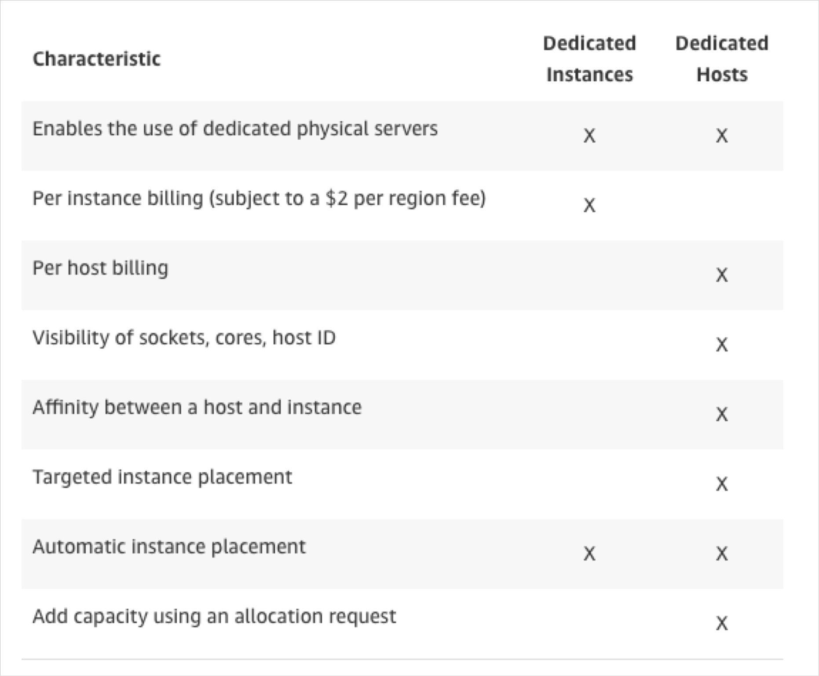
EC2 Dedicated Instances
NOT FOR DISTRIBUTION © Stephane Maarek www.datacumulus.com
Instances running on hardware that’s dedicated to you
May share hardware with other instances in same account
No control over instance placement (can move hardware after Stop / Start)
© Stephane Maarek

Slide 41

Which host is right for me?
NOT FOR DISTRIBUTION © Stephane Maarek www.datacumulus.com
On demand: coming and staying in resort whenever we like, we pay the full price
Reserved: like planning ahead and if we plan to stay for a long time, we may get a good discount.
Spot instances: the hotel allows people to bid for the empty rooms and the highest bidder keeps the rooms.You can get kicked out at any time
Dedicated Hosts: We book an entire building of the resort
© Stephane Maarek

Slide 42
EC2 Instance Types – Main ones
NOT FOR DISTRIBUTION © Stephane Maarek www.datacumulus.com
R: applications that needs a lot of RAM – in-memory caches
C: applications that needs good CPU – compute / databases
M: applications that are balanced (think “medium”) – general / web app
I: applications that need good local I/O (instance storage) – databases
G: applications that need a GPU – video rendering / machine learning
T2 / T3: burstable instances (up to a capacity)
T2 / T3 - unlimited: unlimited burst
Real-world tip: use https://www.ec2instances.info
© Stephane Maarek

Slide 43
Burstable Instances (T2/T3)
NOT FOR DISTRIBUTION © Stephane Maarek www.datacumulus.com
AWS has the concept of burstable instances (T2/T3 machines)
Burst means that overall, the instance has OK CPU performance.
When the machine needs to process something unexpected (a spike in load for example), it can burst, and CPU can be VERY good.
If the machine bursts, it utilizes “burst credits”
If all the credits are gone, the CPU becomes BAD
If the machine stops bursting, credits are accumulated over time
© Stephane Maarek

Slide 44
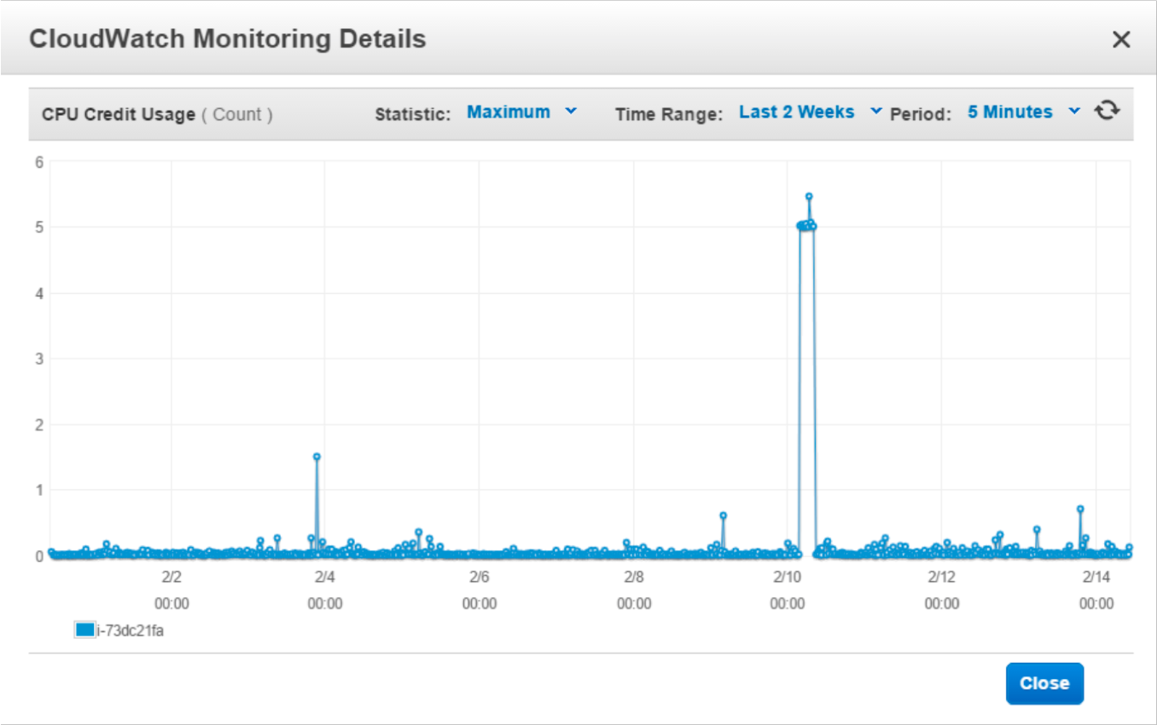
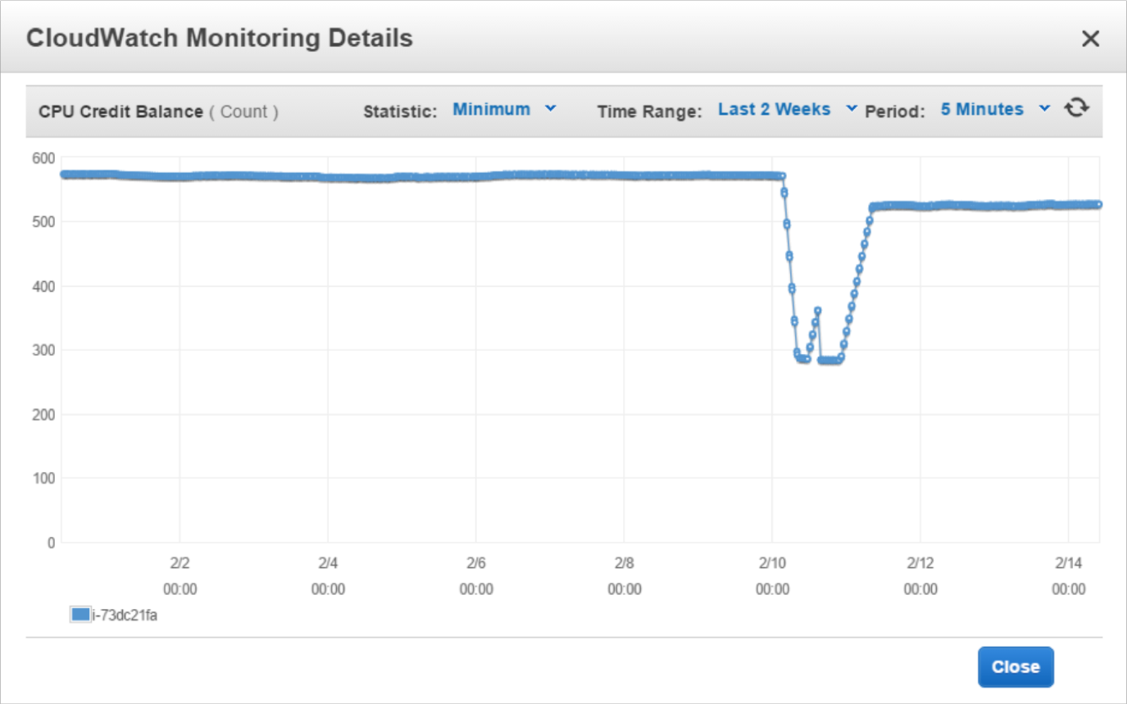
Burstable Instances (T2/T3)
NOT FOR DISTRIBUTION © Stephane Maarek www.datacumulus.com
Burstable instances can be amazing to handle unexpected traffic and getting the insurance that it will be handled correctly
If your instance consistently runs low on credit, you need to move to a different kind of non-burstable instance
Credit usage
Credit balance
© Stephane Maarek

Slide 45
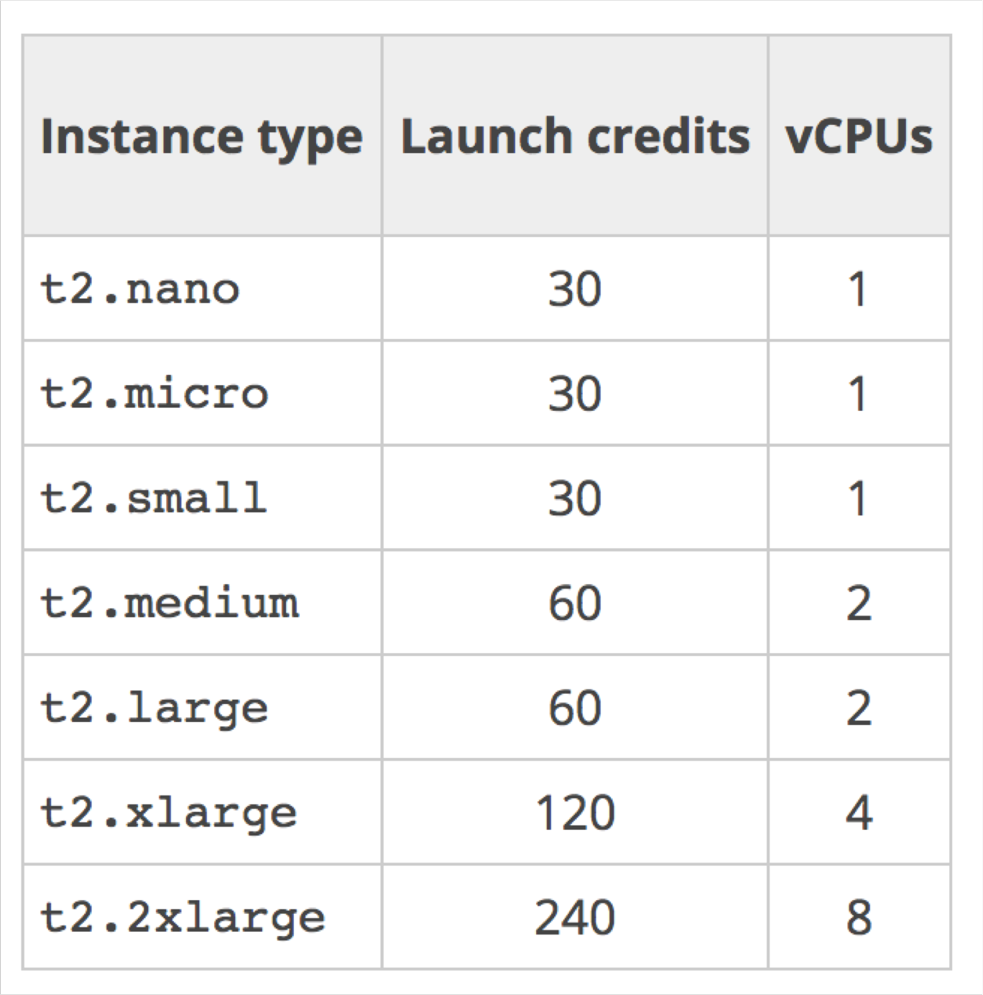
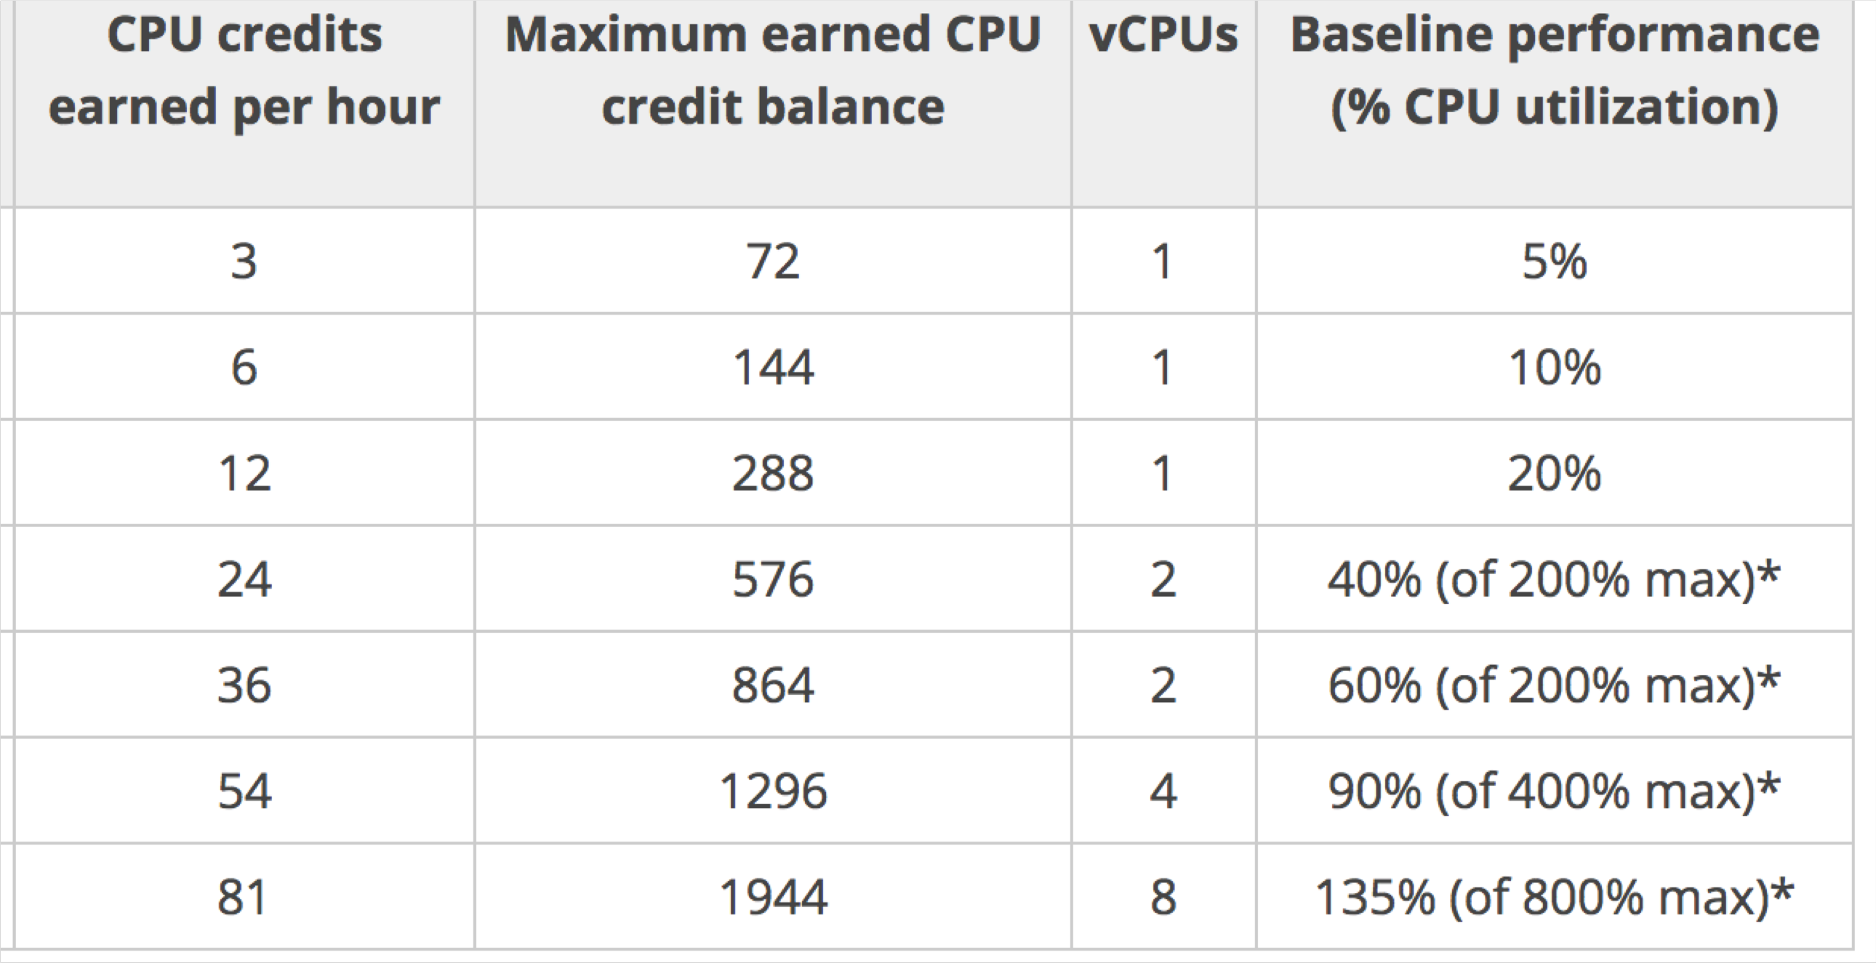
CPU Credits
NOT FOR DISTRIBUTION © Stephane Maarek www.datacumulus.com
© Stephane Maarek

Slide 46
T2/T3 Unlimited
NOT FOR DISTRIBUTION © Stephane Maarek www.datacumulus.com
Nov 2017: It is possible to have an “unlimited burst credit balance”
You pay extra money if you go over your credit balance, but you don’t lose in performance
Overall, it is a new offering, so be careful, costs could go high if you’re not monitoring the health of your instances
Read more here: https://aws.amazon.com/blogs/aws/new-t2-unlimited- going-beyond-the-burst-with-high-performance/
© Stephane Maarek

Slide 47
What’s an AMI?
NOT FOR DISTRIBUTION © Stephane Maarek www.datacumulus.com
As we saw, AWS comes with base images such as:
Ubuntu
Fedora
RedHat
Windows
Etc…
These images can be customised at runtime using EC2 User data
But what if we could create our own image, ready to go?
That’s an AMI – an image to use to create our instances
AMIs can be built for Linux or Windows machines
© Stephane Maarek

Slide 48
Why would you use a custom AMI?
NOT FOR DISTRIBUTION © Stephane Maarek www.datacumulus.com
Using a custom built AMI can provide the following advantages:
Pre-installed packages needed
Faster boot time (no need for ec2 user data at boot time)
Machine comes configured with monitoring / enterprise software
Security concerns – control over the machines in the network
Control of maintenance and updates of AMIs over time
Active Directory Integration out of the box
Installing your app ahead of time (for faster deploys when auto-scaling)
Using someone else’s AMI that is optimised for running an app, DB, etc…
AMI are built for a specific AWS region (!)
© Stephane Maarek

Slide 49
Using Public AMIs
NOT FOR DISTRIBUTION © Stephane Maarek www.datacumulus.com
You can leverage AMIs from other people
You can also pay for other people’s AMI by the hour
These people have optimised the software
The machine is easy to run and configure
You basically rent “expertise” from the AMI creator
AMI can be found and published on the Amazon Marketplace
Warning:
Do not use an AMI you don’t trust!
Some AMIs might come with malware or may not be secure for your enterprise
© Stephane Maarek

Slide 50
AMI Storage
NOT FOR DISTRIBUTION © Stephane Maarek www.datacumulus.com
Your AMI take space and they live in Amazon S3
Amazon S3 is a durable, cheap and resilient storage where most of your backups will live (but you won’t see them in the S3 console)
By default, your AMIs are private, and locked for your account / region
You can also make your AMIs public and share them with other AWS accounts or sell them on the AMI Marketplace
© Stephane Maarek

Slide 51
AMI Pricing
NOT FOR DISTRIBUTION © Stephane Maarek www.datacumulus.com
AMIs live in Amazon S3, so you get charged for the actual space in takes in Amazon S3
Amazon S3 pricing in US-EAST-1:
First 50 TB / month: $0.023 per GB
Next 450 TB / month: $0.022 per GB
Overall it is quite inexpensive to store private AMIs.
Make sure to remove the AMIs you don’t use
© Stephane Maarek

Slide 52
Cross Account AMI Copy (FAQ + Exam Tip)
NOT FOR DISTRIBUTION © Stephane Maarek www.datacumulus.com
You can share an AMI with another AWS account.
Sharing an AMI does not affect the ownership of the AMI.
If you copy an AMI that has been shared with your account, you are the owner of the target AMI in your account.
To copy an AMI that was shared with you from another account, the owner of the source AMI must
grant you read permissions for the storage that backs the AMI, either the associated EBS snapshot (for an Amazon EBS-backed AMI) or an associated S3 bucket (for an instance store-backed AMI).
Limits:
You can't copy an encrypted AMI that was shared with you from another account. Instead, if the
underlying snapshot and encryption key were shared with you, you can copy the snapshot while re- encrypting it with a key of your own.You own the copied snapshot, and can register it as a new AMI.
You can't copy an AMI with an associated billingProduct code that was shared with you from another
account.This includes Windows AMIs and AMIs from the AWS Marketplace.To copy a shared AMI
with a billingProduct code, launch an EC2 instance in your account using the shared AMI and then create an AMI from the instance.
https://docs.aws.amazon.com/AWSEC2/latest/UserGuide/Copy ingAMIs.html
© Stephane Maarek

Slide 53
Placement Groups
NOT FOR DISTRIBUTION © Stephane Maarek www.datacumulus.com
Sometimes you want control over the EC2 Instance placement strategy
That strategy can be defined using placement groups
When you create a placement group, you specify one of the following strategies for the group:
Cluster—clusters instances into a low-latency group in a single Availability Zone
Spread—spreads instances across underlying hardware (max 7 instances per group per AZ)
Not applicable to t2 instances
© Stephane Maarek

Slide 54
Placement Groups Cluster
NOT FOR DISTRIBUTION © Stephane Maarek www.datacumulus.com
EC2 |  |  | EC2 |  |  | EC2
EC2 |  |  | EC2 |  |  | EC2
Placement group Cluster
Low latency 10Gbps network
Same Rack Same AZ
Pros: Great network (10 Gbps bandwidth between instances)
Cons: If the rack fails, all instances fails at the same time
Use case:
Big Data job that needs to complete fast
Application that needs extremely low latency and high network throughput
© Stephane Maarek

Slide 55
Placement Groups Spread
NOT FOR DISTRIBUTION © Stephane Maarek www.datacumulus.com
Pros:
Can span across Availability Zones (AZ)
Reduced risk is simultaneous failure
EC2 Instances are on different physical hardware
Cons:
Limited to 7 instances per AZ per placement group
Use case:
Application that needs to maximize high availability
Cassandra Cluster, Kafka
Cluster, Web application that is distributed
Us-east-1a
Us-east-1b
Us-east-1c
Hardware 1
Hardware 3
Hardware 5
EC2
EC2
EC2
Hardware 2
Hardware 4
Hardware 6
EC2
EC2
EC2
© Stephane Maarek

Slide 56
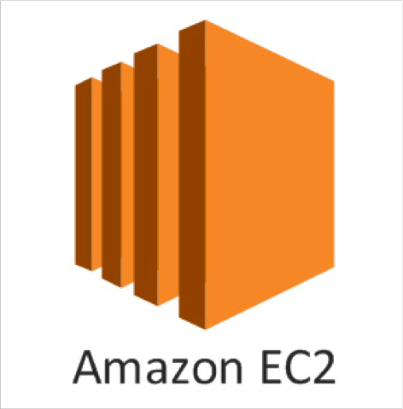
EC2 for Solutions Architects
NOT FOR DISTRIBUTION © Stephane Maarek www.datacumulus.com
EC2 instances are billed by the second, t2.micro is free tier
On Linux / Mac we use SSH, on Windows we use Putty
SSH is on port 22, lock down the security group to your IP
Timeout issues => Security groups issues
Permission issues on the SSH key => run “chmod 0400”
Security Groups can reference other Security Groups instead of IP ranges (very popular exam question)
Know the difference between Private, Public and Elastic IP
You can customize an EC2 instance at boot time using EC2 User Data
© Stephane Maarek

Slide 57
EC2 for Solutions Architects
NOT FOR DISTRIBUTION © Stephane Maarek www.datacumulus.com
Know the 4 EC2 launch modes:
On demand
Reserved
Spot instances
Dedicated Hosts
Know the basic instance types: R,C,M,I,G,T2/T3
You can create AMIs to pre-install software on your EC2 => faster boot
AMI can be copied across regions and accounts
EC2 instances can be started in placement groups:
Cluster
Spread
© Stephane Maarek

Slide 58
NOT FOR DISTRIBUTION © Stephane Maarek www.datacumulus.com
AWS Fundamentals – Part II
Load Balancing, Auto Scaling Groups and EBS Volumes
© Stephane Maarek

Slide 59
Scalability & High Availability
NOT FOR DISTRIBUTION © Stephane Maarek www.datacumulus.com
Scalability means that an application / system can handle greater loads by adapting.
There are two kinds of scalability:
Vertical Scalability
Horizontal Scalability (= elasticity)
Scalability is linked but different to High Availability
Let’s deep dive into the distinction, using a call center as an example
© Stephane Maarek

Slide 60


Vertical Scalability
NOT FOR DISTRIBUTION © Stephane Maarek www.datacumulus.com
Vertically scalability means increasing the size of the instance
For example, your application runs on a t2.micro
Scaling that application vertically means running it on a t2.large
Vertical scalability is very common for non distributed systems, such as a database.
RDS, ElastiCache are services that can scale vertically.
There’s usually a limit to how much you can vertically scale (hardware limit)
junior operator
senior operator
© Stephane Maarek

Slide 61






Horizontal Scalability
NOT FOR DISTRIBUTION © Stephane Maarek www.datacumulus.com
operator
operator
operator
Horizontal Scalability means increasing the number of instances / systems for your application
Horizontal scaling implies distributed systems.
This is very common for web applications / modern applications
It’s easy to horizontally scale thanks the cloud offerings such as Amazon EC2
operator
operator
operator
© Stephane Maarek

Slide 62






High Availability
NOT FOR DISTRIBUTION © Stephane Maarek www.datacumulus.com
first building in New York
High Availability usually goes hand in hand with horizontal scaling
High availability means running your
application / system in at least 2 data centers (== Availability Zones)
The goal of high availability is to survive a data center loss
second building in San Francisco
The high availability can be passive (for RDS Multi AZ for example)
The high availability can be active (for horizontal scaling)
© Stephane Maarek

Slide 63
High Availability & Scalability For EC2
NOT FOR DISTRIBUTION © Stephane Maarek www.datacumulus.com
Vertical Scaling: Increase instance size (= scale up / down)
From: t2.nano - 0.5G of RAM, 1 vCPU
To: u-12tb1.metal – 12.3 TB of RAM, 448 vCPUs
Horizontal Scaling: Increase number of instances (= scale out / in)
Auto Scaling Group
Load Balancer
High Availability: Run instances for the same application across multi AZ
Auto Scaling Group multi AZ
Load Balancer multi AZ
© Stephane Maarek

Slide 64
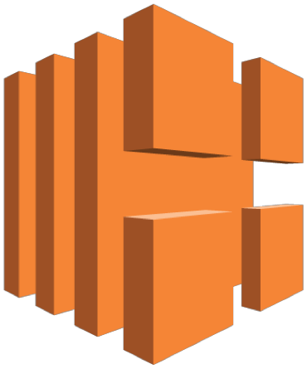

What is load balancing?
NOT FOR DISTRIBUTION © Stephane Maarek www.datacumulus.com
Load balancers are servers that forward internet traffic to multiple servers (EC2 Instances) downstream.
EC2
Instance
Load Balancer
User 1
User 2
User 3
EC2
Instance
EC2
Instance
© Stephane Maarek

Slide 65
Why use a load balancer?
NOT FOR DISTRIBUTION © Stephane Maarek www.datacumulus.com
Spread load across multiple downstream instances
Expose a single point of access (DNS) to your application
Seamlessly handle failures of downstream instances
Do regular health checks to your instances
Provide SSL termination (HTTPS) for your websites
Enforce stickiness with cookies
High availability across zones
Separate public traffic from private traffic
© Stephane Maarek

Slide 66
Why use an EC2 Load Balancer?
NOT FOR DISTRIBUTION © Stephane Maarek www.datacumulus.com
An ELB (EC2 Load Balancer) is a managed load balancer
AWS guarantees that it will be working
AWS takes care of upgrades, maintenance, high availability
AWS provides only a few configuration knobs
It costs less to setup your own load balancer but it will be a lot more effort on your end.
It is integrated with many AWS offerings / services
© Stephane Maarek

Slide 67
Types of load balancer on AWS
NOT FOR DISTRIBUTION © Stephane Maarek www.datacumulus.com
AWS has 3 kinds of Load Balancers
Classic Load Balancer (v1 - old generation) - 2009
Application Load Balancer (v2 - new generation) - 2016
Network Load Balancer (v2 - new generation) - 2017
Overall, it is recommended to use the newer / v2 generation load balancers as they provide more features
You can setup internal (private) or external (public) ELBs
© Stephane Maarek

Slide 68
Health Checks
NOT FOR DISTRIBUTION © Stephane Maarek www.datacumulus.com
Health Checks are crucial for Load Balancers
They enable the load balancer to know if instances it forwards traffic to are available to reply to requests
The health check is done on a port and a route (/health is common)
If the response is not 200 (OK), then the instance is unhealthy
Classic Load Balancer (v1)
EC2
Instances
Health Checks
Port 4567 Route /health
© Stephane Maarek

Slide 69
Application Load Balancer (v2)
NOT FOR DISTRIBUTION © Stephane Maarek www.datacumulus.com
Application load balancers (Layer 7) allow to do:
Load balancing to multiple HTTP applications across machines (target groups)
Load balancing to multiple applications on the same machine (ex: containers)
Load balancing based on route in URL
Load balancing based on hostname in URL
Basically, they’re awesome for micro services & container-based application (example: Docker & Amazon ECS)
Has a port mapping feature to redirect to a dynamic port
In comparison, we would need to create one Classic Load Balancer per application before.That was very expensive and inefficient!
© Stephane Maarek

Slide 70

Application Load Balancer (v2) HTTP Based Traffic
NOT FOR DISTRIBUTION © Stephane Maarek www.datacumulus.com
Target Group for Users application
EC2
Instance
Health Check
WWW
Route /user
HTTP
EC2
Instance
External Application Load Balancer (v2)
Target Group for Search application
EC2
Instance
Health Check
WWW
Route /search
HTTP
EC2
Instance
© Stephane Maarek

Slide 71

Application Load Balancer v2 Good to Know
NOT FOR DISTRIBUTION © Stephane Maarek www.datacumulus.com
Stickiness can be enabled at the target group level
Same request goes to the same instance
Stickiness is directly generated by the ALB (not the application)
ALB support HTTP/HTTPS & Websockets protocols
The application servers don’t see the IP of the client directly
The true IP of the client is inserted in the header X-Forwarded-For
We can also get Port (X-Forwarded-Port) and proto (X-Forwarded-Proto)
Load Balancer IP (Private IP)
Client IP 12.34.56.78
EC2
Instance
Connection termination
© Stephane Maarek

Slide 72
Network Load Balancer (v2)
NOT FOR DISTRIBUTION © Stephane Maarek www.datacumulus.com
Network load balancers (Layer 4) allow to do:
Forward TCP traffic to your instances
Handle millions of request per seconds
Support for static IP or elastic IP
Less latency ~100 ms (vs 400 ms for ALB)
Network Load Balancers are mostly used for extreme performance and should not be the default load balancer you choose
Overall, the creation process is the same as Application Load Balancers
© Stephane Maarek

Slide 73

Network Load Balancer (v2) TCP Based Traffic
NOT FOR DISTRIBUTION © Stephane Maarek www.datacumulus.com
Target Group for Users application
EC2
Instance
Health Check
WWW
TCP + Rules
TCP
EC2
Instance
External Network Load Balancer (v2)
Target Group for Search application
EC2
Instance
Health Check
WWW
TCP + Rules
TCP
EC2
Instance
© Stephane Maarek

Slide 74
Load Balancer Good to Know
NOT FOR DISTRIBUTION © Stephane Maarek www.datacumulus.com
Classic Load Balancers are Deprecated
Application Load Balancers for HTTP / HTTPs & Websocket
Network Load Balancer for TCP
CLB, ALB & NLB support SSL certificates and provide SSL termination
All Load Balancers have health check capability
ALB can route on based on hostname / path
ALB is a great fit with ECS (Docker)
© Stephane Maarek

Slide 75
Load Balancer Good to Know
NOT FOR DISTRIBUTION © Stephane Maarek www.datacumulus.com
Any Load Balancer (CLB, ALB, NLB) has a static host name. Do not resolve and use underlying IP
LBs can scale but not instantaneously – contact AWS for a “warm-up”
NLB directly see the client IP
4xx errors are client induced errors
5xx errors are application induced errors
Load Balancer Errors 503 means at capacity or no registered target
If the LB can’t connect to your application, check your security groups!
© Stephane Maarek

Slide 76

Load Balancer Stickiness
NOT FOR DISTRIBUTION © Stephane Maarek www.datacumulus.com
It is possible to implement stickiness so
that the same client is always redirected
to the same instance behind a load balancer
This works for Classic Load Balancers & Application Load Balancers
The “cookie” used for stickiness has an expiration date you control
Use case: make sure the user doesn’t lose his session data
Enabling stickiness may bring imbalance to the load over the backend EC2 instances
Client A
Client B
Client C
EC2
Instance
EC2
Instance
© Stephane Maarek

Slide 77
Load Balancers for Solutions Architect
NOT FOR DISTRIBUTION © Stephane Maarek www.datacumulus.com
Classic Load Balancers: questions on security groups, stickiness
Application Load Balancer (Layer 7 of OSI):
Support routing based on hostname (users.example.com & payments.example.com)
Support routing based on path (example.com/users & example.com/payments)
Support redirects (from HTTP to HTTPS for example)
Support dynamic host port mapping with ECS
NLB (Layer 4 of OSI) gets a static IP per AZ :
Public facing: must attach Elastic IP – can help whitelist by clients
Private facing: will get random private IP based on free ones at time of creation
Has cross zone balancing
Has SSL termination (Jan 2019)
© Stephane Maarek

Slide 78

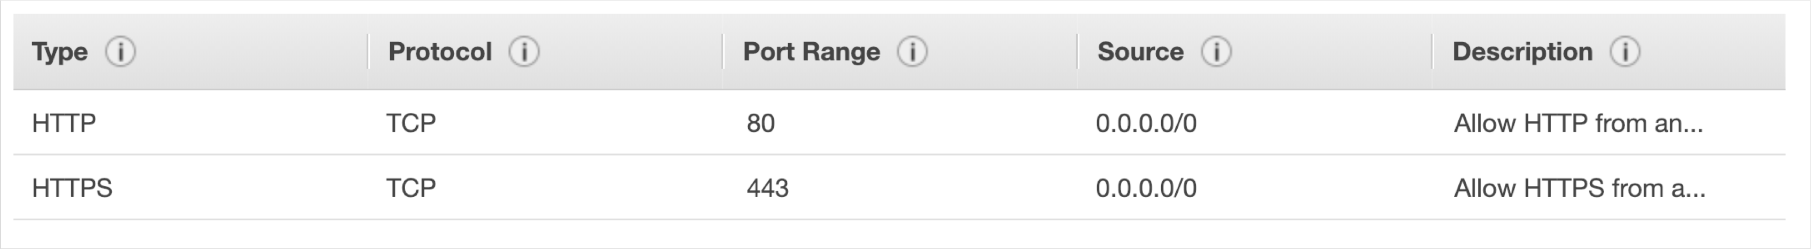
Load Balancer Security Groups
LOAD BALANCER
NOT FOR DISTRIBUTION © Stephane Maarek www.datacumulus.com
HTTPS / HTTP
From anywhere
HTTP Restricted to Load balancer
EC2
Instance
Users
Load Balancer Security Group:
Application Security Group: Allow traffic only from Load Balancer
© Stephane Maarek

Slide 79
Load Balancer - SSL Certificates
LOAD BALANCER
NOT FOR DISTRIBUTION © Stephane Maarek www.datacumulus.com
HTTPS (encrypted) Over www
HTTP
Over private VPC
EC2
Instance
Users
The load balancer uses an X.509 certificate (SSL/TLS server certificate)
You can manage certificates using ACM (AWS Certificate Manager)
You can create upload your own certificates alternatively
HTTPS listener:
You must specify a default certificate
You can add an optional list of certs to support multiple domains
Clients can use SNI (Server Name Indication) to specify the hostname they reach
Ability to specify a security policy to support older versions of SSL / TLS (legacy clients)
© Stephane Maarek

Slide 80

What’s an Auto Scaling Group?
NOT FOR DISTRIBUTION © Stephane Maarek www.datacumulus.com
In real-life, the load on your websites and application can change
In the cloud, you can create and get rid of servers very quickly
The goal of an Auto Scaling Group (ASG) is to:
Scale out (add EC2 instances) to match an increased load
Scale in (remove EC2 instances) to match a decreased load
Ensure we have a minimum and a maximum number of machines running
Automatically Register new instances to a load balancer
© Stephane Maarek

Slide 81
Auto Scaling Group in AWS
NOT FOR DISTRIBUTION © Stephane Maarek www.datacumulus.com
Maximum size
Actual Size / Desired Capacity
Minimum size
Scale Out as Needed
EC2
Instance
EC2
Instance
EC2
Instance
EC2
Instance
EC2
Instance
EC2
Instance
AUTO SCALING GROUP
© Stephane Maarek

Slide 82

Auto Scaling Group in AWS With Load Balancer
NOT FOR DISTRIBUTION © Stephane Maarek www.datacumulus.com
Web Traffic
Load Balancer
EC2
Instance
EC2
Instance
EC2
Instance
EC2
Instance
EC2
Instance
EC2
Instance
AUTO SCALING GROUP
© Stephane Maarek

Slide 83
ASGs have the following attributes
NOT FOR DISTRIBUTION © Stephane Maarek www.datacumulus.com
A launch configuration
AMI + Instance Type
EC2 User Data
EBS Volumes
Security Groups
SSH Key Pair
Min Size / Max Size / Initial Capacity
Network + Subnets Information
Load Balancer Information
Scaling Policies
© Stephane Maarek

Slide 84

Auto Scaling Alarms
NOT FOR DISTRIBUTION © Stephane Maarek www.datacumulus.com
It is possible to scale an ASG based on CloudWatch alarms
An Alarm monitors a metric (such as Average CPU)
Metrics are computed for the overall ASG instances
Based on the alarm:
We can create scale-out policies (increase the number of instances)
We can create scale-in policies (decrease the number of instances)
Alarm
EC2
Instance
EC2
Instance
EC2
Instance
EC2
Instance
Trigger scaling
© Stephane Maarek

Slide 85
Auto Scaling New Rules
NOT FOR DISTRIBUTION © Stephane Maarek www.datacumulus.com
It is now possible to define ”better” auto scaling rules that are directly managed by EC2
Target Average CPU Usage
Number of requests on the ELB per instance
Average Network In
Average Network Out
These rules are easier to set up and can make more sense
© Stephane Maarek

Slide 86
Auto Scaling Custom Metric
NOT FOR DISTRIBUTION © Stephane Maarek www.datacumulus.com
We can auto scale based on a custom metric (ex: number of connected users)
1. Send custom metric from application on EC2 to CloudWatch (PutMetric API)
2. Create CloudWatch alarm to react to low / high values
3. Use the CloudWatch alarm as the scaling policy for ASG
© Stephane Maarek

Slide 87
ASG Brain Dump
NOT FOR DISTRIBUTION © Stephane Maarek www.datacumulus.com
Scaling policies can be on CPU, Network… and can even be on custom metrics or based on a schedule (if you know your visitors patterns)
ASGs use Launch configurations and you update an ASG by providing a new launch configuration
IAM roles attached to an ASG will get assigned to EC2 instances
ASG are free.You pay for the underlying resources being launched
Having instances under an ASG means that if they get terminated for whatever reason, the ASG will restart them. Extra safety!
ASG can terminate instances marked as unhealthy by an LB (and hence replace them)
© Stephane Maarek

Slide 88








ASG for Solutions Architects
NOT FOR DISTRIBUTION © Stephane Maarek www.datacumulus.com
ASG Default Termination Policy (simplified version):
Find the AZ which has the most number of instances
If there are multiple instances in the AZ to choose from, delete the one with the oldest launch configuration
ASG tries the balance the number of instances across AZ by default
 | Availability zone A |  | Availability zone B
 | v1 v2 v1 v2 | Auto Scaling group | v1 v1 v1
© Stephane Maarek

Slide 89
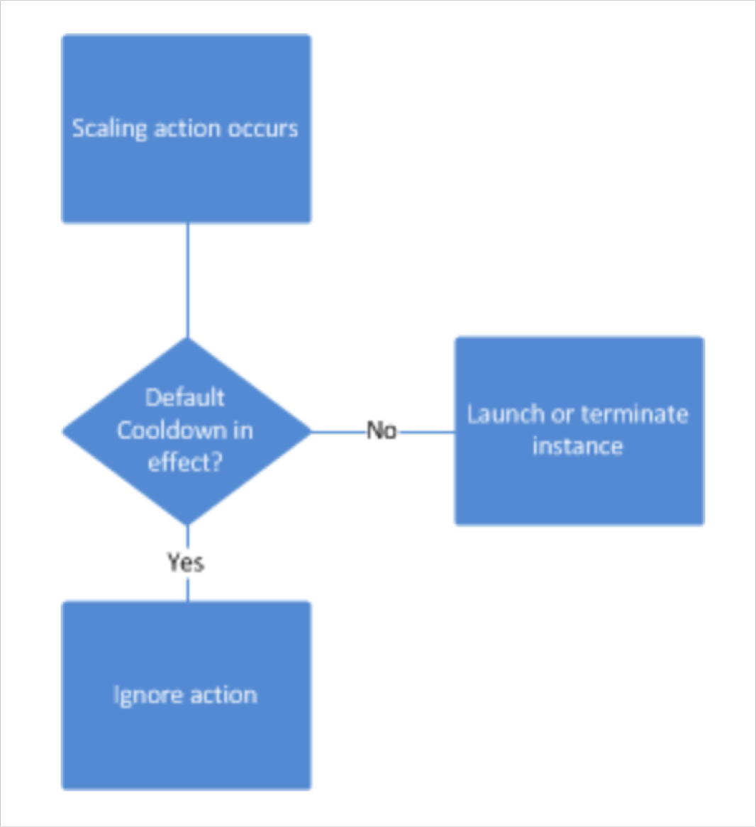
ASG for Solutions Architects Scaling Cooldowns
NOT FOR DISTRIBUTION © Stephane Maarek www.datacumulus.com
The cooldown period helps to ensure that your Auto Scaling group doesn't
launch or terminate additional instances before the previous scaling activity takes effect.
In addition to default cooldown for Auto Scaling group, we can create cooldowns that apply to a specific simple scaling policy
A scaling-specific cooldown period overrides the default cooldown period.
One common use for scaling-specific cooldowns is with a scale-in policy—a policy
that terminates instances based on a specific criteria or metric. Because this policy
terminates instances, Amazon EC2 Auto Scaling needs less time to determine whether to terminate additional instances.
If the default cooldown period of 300 seconds is too long—you can reduce costs
by applying a scaling-specific cooldown period of 180 seconds to the scale-in policy.
If your application is scaling up and down multiple times each hour, modify the
Auto Scaling Groups cool-down timers and the CloudWatch Alarm Period that triggers the scale in
https://docs.aws.amazon.com/autoscaling/ec2/userguide/Cooldown.html
© Stephane Maarek

Slide 90
EBS & EFS
NOT FOR DISTRIBUTION © Stephane Maarek www.datacumulus.com
© Stephane Maarek

Slide 91

What’s an EBS Volume?
NOT FOR DISTRIBUTION © Stephane Maarek www.datacumulus.com
An EC2 machine loses its root volume (main drive) when it is manually terminated.
Unexpected terminations might happen from time to time (AWS would email you)
Sometimes, you need a way to store your instance data somewhere
An EBS (Elastic Block Store) Volume is a network drive you can attach to your instances while they run
It allows your instances to persist data
Amazon EBS
© Stephane Maarek

Slide 92
EBS Volume
NOT FOR DISTRIBUTION © Stephane Maarek www.datacumulus.com
It’s a network drive (i.e. not a physical drive)
It uses the network to communicate the instance, which means there might be a bit of latency
It can be detached from an EC2 instance and attached to another one quickly
It’s locked to an Availability Zone (AZ)
An EBS Volume in us-east-1a cannot be attached to us-east-1b
To move a volume across, you first need to snapshot it
Have a provisioned capacity (size in GBs, and IOPS)
You get billed for all the provisioned capacity
You can increase the capacity of the drive over time
© Stephane Maarek

Slide 93
EBS Volume Example
NOT FOR DISTRIBUTION © Stephane Maarek www.datacumulus.com
US-EAST-1A
US-EAST-1B
EC2
EC2
EC2
EC2
EC2
EBS (10GB)
EBS (100GB)
EBS (50GB)
EBS (50GB)
© Stephane Maarek

Slide 94
EBS Volume Types
NOT FOR DISTRIBUTION © Stephane Maarek www.datacumulus.com
EBS Volumes come in 4 types
GP2 (SSD): General purpose SSD volume that balances price and performance for a wide variety of workloads
IO1 (SSD): Highest-performance SSD volume for mission-critical low-latency or high- throughput workloads
ST1 (HDD): Low cost HDD volume designed for frequently accessed, throughput- intensive workloads
SC1 (HDD): Lowest cost HDD volume designed for less frequently accessed workloads
EBS Volumes are characterized in Size | Throughput | IOPS (I/O Ops Per Sec)
When in doubt always consult the AWS documentation – it’s good!
Only GP2 and IO1 can be used as boot volumes
© Stephane Maarek

Slide 95
EBS Volume Types Use cases GP2 (from AWS doc)
NOT FOR DISTRIBUTION © Stephane Maarek www.datacumulus.com
Recommended for most workloads
System boot volumes
Virtual desktops
Low-latency interactive apps
Development and test environments
1 GiB - 16 TiB
Small gp2 volumes can burst IOPS to 3000
Max IOPS is 16,000…
3 IOPS per GB, means at 5,334GB we are at the max IOPS
© Stephane Maarek

Slide 96
EBS Volume Types Use cases IO1 (from AWS doc)
NOT FOR DISTRIBUTION © Stephane Maarek www.datacumulus.com
Critical business applications that require sustained IOPS performance, or more than 16,000 IOPS per volume (gp2 limit)
Large database workloads, such as:
MongoDB, Cassandra, Microsoft SQL Server, MySQL, PostgreSQL, Oracle
4 GiB - 16 TiB
IOPS is provisioned (PIOPS) – MIN 100 - MAX 64,000 (Nitro instances) else MAX 32,000 (other instances)
The maximum ratio of provisioned IOPS to requested volume size (in GiB) is 50:1
© Stephane Maarek

Slide 97
EBS Volume Types Use cases ST1 (from AWS doc)
NOT FOR DISTRIBUTION © Stephane Maarek www.datacumulus.com
Streaming workloads requiring consistent, fast throughput at a low price.
Big data, Data warehouses, Log processing
Apache Kafka
Cannot be a boot volume
500 GiB - 16 TiB
Max IOPS is 500
Max throughput of 500 MiB/s – can burst
© Stephane Maarek

Slide 98
EBS Volume Types Use cases SC1 (from AWS doc)
NOT FOR DISTRIBUTION © Stephane Maarek www.datacumulus.com
Throughput-oriented storage for large volumes of data that is infrequently accessed
Scenarios where the lowest storage cost is important
Cannot be a boot volume
500 GiB - 16 TiB
Max IOPS is 250
Max throughput of 250 MiB/s – can burst
© Stephane Maarek

Slide 99
EBS Snapshots
NOT FOR DISTRIBUTION © Stephane Maarek www.datacumulus.com
Incremental – only backup changed blocks
EBS backups use IO and you shouldn’t run them while your application is handling a lot of traffic
Snapshots will be stored in S3 (but you won’t directly see them)
Not necessary to detach volume to do snapshot, but recommended
Max 100,000 snapshots
Can copy snapshots across AZ or Region
Can make Image (AMI) from Snapshot
EBS volumes restored by snapshots need to be pre-warmed (using fio or dd command to read the entire volume)
Snapshots can be automated using Amazon Data Lifecycle Manager
© Stephane Maarek

Slide 100
EBS Migration
NOT FOR DISTRIBUTION © Stephane Maarek www.datacumulus.com
EBS Volumes are only locked to a specific AZ
To migrate it to a different AZ (or region):
Snapshot the volume
(optional) Copy the volume to a different region
Create a volume from the snapshot in the AZ of your choice
Let’s practice!
© Stephane Maarek

Slide 101
EBS Encryption
NOT FOR DISTRIBUTION © Stephane Maarek www.datacumulus.com
When you create an encrypted EBS volume, you get the following:
Data at rest is encrypted inside the volume
All the data in flight moving between the instance and the volume is encrypted
All snapshots are encrypted
All volumes created from the snapshot
Encryption and decryption are handled transparently (you have nothing to do)
Encryption has a minimal impact on latency
EBS Encryption leverages keys from KMS (AES-256)
Copying an unencrypted snapshot allows encryption
Snapshots of encrypted volumes are encrypted
© Stephane Maarek

Slide 102
Encryption: encrypt an unencrypted EBS volume
NOT FOR DISTRIBUTION © Stephane Maarek www.datacumulus.com
Create an EBS snapshot of the volume
Encrypt the EBS snapshot ( using copy )
Create new ebs volume from the snapshot ( the volume will also be encrypted )
Now you can attach the encrypted volume to the original instance
© Stephane Maarek

Slide 103
EBS vs Instance Store
NOT FOR DISTRIBUTION © Stephane Maarek www.datacumulus.com
Some instance do not come with Root EBS volumes
Instead, they come with “Instance Store” (= ephemeral storage)
Instance store is physically attached to the machine (EBS is a network drive)
Pros:
Better I/O performance
Good for buffer / cache / scratch data / temporary content
Data survives reboots
Cons:
On stop or termination, the instance store is lost
You can’t resize the instance store
Backups must be operated by the user
© Stephane Maarek

Slide 104
EBS RAID Options
NOT FOR DISTRIBUTION © Stephane Maarek www.datacumulus.com
EBS is already redundant storage (replicated within an AZ)
But what if you want to increase IOPS to say 100 000 IOPS?
What if you want to mirror your EBS volumes?
You would mount volumes in parallel in RAID settings!
RAID is possible as long as your OS supports it
Some RAID options are:
RAID 0
RAID 1
RAID 5 (not recommended for EBS – see documentation)
RAID 6 (not recommended for EBS – see documentation)
We’ll explore RAID 0 and RAID 1
© Stephane Maarek

Slide 105



RAID 0 (increase performance)
NOT FOR DISTRIBUTION © Stephane Maarek www.datacumulus.com
Combining 2 or more volumes and getting the total disk space and I/O
But one disk fails, all the data is failed
EC2 instance
Use cases would be:
An application that needs a lot of IOPS and doesn’t need fault-tolerance
A database that has replication already built-in
Using this, we can have a very big disk with a lot of IOPS
For example
two 500 GiB Amazon EBS io1 volumes with 4,000 provisioned IOPS each will create a…
1000 GiB RAID 0 array with an available bandwidth of 8,000 IOPS and 1,000 MB/s of throughput
One logical volume
either
A
B
C
D
EBS Volume 1
EBS Volume 2
© Stephane Maarek

Slide 106
RAID 1 (increase fault tolerance)
NOT FOR DISTRIBUTION © Stephane Maarek www.datacumulus.com
RAID 1 = Mirroring a volume to another
If one disk fails, our logical volume is still working
We have to send the data to two EBS volume at
EC2 instance
the same time (2x network)
Use case:
Application that need increase volume fault tolerance
Application where you need to service disks
For example:
two 500 GiB Amazon EBS io1 volumes with 4,000 provisioned IOPS each will create a…
500 GiB RAID 1 array with an available bandwidth of 4,000 IOPS and 500 MB/s of throughput
One logical volume
both
A
A
B
B
C
C
EBS Volume 1
EBS Volume 2
© Stephane Maarek

Slide 107
EFS – Elastic File System
NOT FOR DISTRIBUTION © Stephane Maarek www.datacumulus.com
Managed NFS (network file system) that can be mounted on many EC2
EFS works with EC2 instances in multi-AZ
Highly available, scalable, expensive (3x gp2), pay per use
EC2
us-east-1a
EC2
us-east-1b
EC2
us-east-1c
Security Group
EFS
© Stephane Maarek

Slide 108
EFS – Elastic File System
NOT FOR DISTRIBUTION © Stephane Maarek www.datacumulus.com
Use cases: content management, web serving, data sharing, Wordpress
Uses NFSv4.1 protocol
Uses security group to control access to EFS
Compatible with Linux based AMI (not Windows)
Performance mode:
General purpose (default)
Max I/O – used when thousands of EC2 are using the EFS
EFS file sync to sync from on-premise file system to EFS
Backup EFS-to-EFS (incremental – can choose frequency)
Encryption at rest using KMS
© Stephane Maarek

Slide 109
EBS & EFS For Solutions Architect
NOT FOR DISTRIBUTION © Stephane Maarek www.datacumulus.com
EBS volumes can be attached to only one instance at a time
EBS volumes are locked at the AZ level
Migrating an EBS volume across AZ means first backing it up (snapshot), then recreating it in the other AZ
EBS backups use IO and you shouldn’t run them while your application is handling a lot of traffic
Root EBS Volumes of instances get terminated by default if the EC2 instance gets terminated. (you can disable that)
© Stephane Maarek

Slide 110
EBS & EFS For Solutions Architect
NOT FOR DISTRIBUTION © Stephane Maarek www.datacumulus.com
Disk IO is high => Increase EBS volume size (for gp2)
EFS mounting 100s of instances
EFS share website files
EBS gp2, optimize on cost
Custom AMI for faster deploy on ASG
EFS vs EBS vs Instance Store
Solution architecture on EBS / EFS is discussed in a later section
© Stephane Maarek

Slide 111
RDS, Aurora & ElastiCache
NOT FOR DISTRIBUTION © Stephane Maarek www.datacumulus.com
© Stephane Maarek

Slide 112

AWS RDS Overview
NOT FOR DISTRIBUTION © Stephane Maarek www.datacumulus.com
RDS stands for Relational Database Service
It’s a managed DB service for DB use SQL as a query language.
It allows you to create databases in the cloud that are managed by AWS
Postgres
MySQL
MariaDB
Oracle
Microsoft SQL Server
Aurora (AWS Proprietary database)
© Stephane Maarek

Slide 113
Advantage over using RDS versus deploying DB on EC2
NOT FOR DISTRIBUTION © Stephane Maarek www.datacumulus.com
Managed service:
OS patching level
Continuous backups and restore to specific timestamp (Point in Time Restore)!
Monitoring dashboards
Read replicas for improved read performance
Multi AZ setup for DR (Disaster Recovery)
Maintenance windows for upgrades
Scaling capability (vertical and horizontal)
BUT you can’t SSH into your instances
© Stephane Maarek

Slide 114



RDS Read Replicas for read scalability
NOT FOR DISTRIBUTION © Stephane Maarek www.datacumulus.com
Up to 5 Read Replicas
Within AZ, Cross AZ or Cross Region
Replication is ASYNC,
so reads are eventually consistent
Replicas can be
promoted to their own DB
Applications must
update the connection
string to leverage read replicas
Application
reads
writes
reads
reads
ASYNC
replication
ASYNC
replication
RDS DB
instance read replica
RDS DB
instance
RDS DB
instance read replica
© Stephane Maarek

Slide 115


RDS Multi AZ (Disaster Recovery)
NOT FOR DISTRIBUTION © Stephane Maarek www.datacumulus.com
SYNC replication
One DNS name – automatic app failover to standby
Increase availability
Failover in case of loss of AZ, loss of network, instance or storage failure
No manual intervention in apps
Not used for scaling
Application
writes
reads
One DNS name – automatic failover
SYNC
replication
RDS DB
instance standby (AZ B)
RDS Master DB instance (AZ A)
© Stephane Maarek

Slide 116
RDS Backups
NOT FOR DISTRIBUTION © Stephane Maarek www.datacumulus.com
Backups are automatically enabled in RDS
Automated backups:
Daily full snapshot of the database
Capture transaction logs in real time
• => ability to restore to any point in time
7 days retention (can be increased to 35 days)
DB Snapshots:
Manually triggered by the user
Retention of backup for as long as you want
© Stephane Maarek

Slide 117
RDS Encryption
NOT FOR DISTRIBUTION © Stephane Maarek www.datacumulus.com
Encryption at rest capability with AWS KMS - AES-256 encryption
SSL certificates to encrypt data to RDS in flight
To enforce SSL:
PostgreSQL: rds.force_ssl=1 in the AWS RDS Console (Paratemer Groups)
MySQL: Within the DB:
GRANT USAGE ON *.* TO 'mysqluser'@'%' REQUIRE SSL;
To connect using SSL:
Provide the SSL Trust certificate (can be download from AWS)
Provide SSL options when connecting to database
© Stephane Maarek

Slide 118
RDS Security
NOT FOR DISTRIBUTION © Stephane Maarek www.datacumulus.com
RDS databases are usually deployed within a private subnet, not in a public one
RDS Security works by leveraging security groups (the same concept as for EC2 instances) – it controls who can communicate with RDS
IAM policies help control who can manage AWS RDS
Traditional Username and Password can be used to login to the database
IAM users can now be used too (for MySQL / Aurora – NEW!)
© Stephane Maarek

Slide 119
RDS vs Aurora
NOT FOR DISTRIBUTION © Stephane Maarek www.datacumulus.com
Aurora is a proprietary technology from AWS (not open sourced)
Postgres and MySQL are both supported as Aurora DB (that means your drivers will work as if Aurora was a Postgres or MySQL database)
Aurora is “AWS cloud optimized” and claims 5x performance improvement over MySQL on RDS, over 3x the performance of Postgres on RDS
Aurora storage automatically grows in increments of 10GB, up to 64 TB.
Aurora can have 15 replicas while MySQL has 5, and the replication process is faster (sub 10 ms replica lag)
Failover in Aurora is instantaneous. It’s HA native.
Aurora costs more than RDS (20% more) – but is more efficient
© Stephane Maarek

Slide 120
RDS Security for SysOps
NOT FOR DISTRIBUTION © Stephane Maarek www.datacumulus.com
Encryption at rest:
Is done only when you first create the DB instance
or: unencrypted DB => snapshot => copy snapshot as encrypted => create DB from snapshot
Your responsibility:
Check the ports / IP / security group inbound rules in DB’s SG
In-database user creation and permissions
Creating a database with or without public access
Ensure parameter groups or DB is configured to only allow SSL connections
AWS responsibility:
No SSH access
No manual DB patching
No manual OS patching
No way to audit the underlying instance
© Stephane Maarek

Slide 121
RDS for Solutions Architects
NOT FOR DISTRIBUTION © Stephane Maarek www.datacumulus.com
Read replicas are used for SELECT (=read) only kind of statements (not INSERT, UPDATE, DELETE)
Amazon RDS supports Transparent Data Encryption for DB encryption:
Oracle or SQL Server DB instance only
TDE can be used on top of KMS – may affect performance
IAM Authentication (versus traditional username / password):
Works for MySQL, PostgreSQL
Lifespan of an authentication token is 15 minutes (short-lived)
Tokens are generated by AWS credentials
SSL must be used when connecting to the database
Easy to use EC2 Instance Roles to connect to the RDS database
© Stephane Maarek

Slide 122
Amazon Aurora
NOT FOR DISTRIBUTION © Stephane Maarek www.datacumulus.com
Aurora is a proprietary technology from AWS (not open sourced)
Postgres and MySQL are both supported as Aurora DB (that means your drivers will work as if Aurora was a Postgres or MySQL database)
Aurora is “AWS cloud optimized” and claims 5x performance improvement over MySQL on RDS, over 3x the performance of Postgres on RDS
Aurora storage automatically grows in increments of 10GB, up to 64 TB.
Aurora can have 15 replicas while MySQL has 5, and the replication process is faster (sub 10 ms replica lag)
Failover in Aurora is instantaneous. It’s HA native.
Aurora costs more than RDS (20% more) – but is more efficient
© Stephane Maarek

Slide 123






Aurora High Availability and Read Scaling
NOT FOR DISTRIBUTION © Stephane
6 copies of your data across 3 AZ:
4 copies out of 6 needed for writes
3 copies out of 6 need for reads
Self healing with peer-to-peer replication
Storage is striped across 100s of volumes
One Aurora Instance takes writes (master)
Automated failover for master in less than 30 seconds
Master + up to 15 Aurora Read Replicas serve reads
Support for Cross Region Replication
AZ 1 W _{R} | AZ 2 R R | AZ 3 R R
Shared storage Volume Replication + Self Healing + Auto Expanding
M
r
a a ek www.datacumulus.com
© Stephane Maarek

Slide 124







Aurora DB Cluster
NOT FOR DISTRIBUTION © Stephane Maarek www.datacumulus.com
client
Writer Endpoint
Pointing to the master
Reader Endpoint
Connection Load Balancing
Auto Scaling
W
R
R R R
Shared storage Volume
Auto Expanding from 10G to 64 TB
R
© Stephane Maarek

Slide 125
Features of Aurora
NOT FOR DISTRIBUTION © Stephane Maarek www.datacumulus.com
Automatic fail-over
Backup and Recovery
Isolation and security
Industry compliance
Push-button scaling
Automated Patching with Zero Downtime
Advanced Monitoring
Routine Maintenance
Backtrack: restore data at any point of time without using backups
© Stephane Maarek

Slide 126
Aurora Security
NOT FOR DISTRIBUTION © Stephane Maarek www.datacumulus.com
Encryption at rest using KMS
Automated backups, snapshots and replicas are also encrypted
Encryption in flight using SSL (same process as MySQL or Postgres)
Authentication using IAM
You are responsible for protecting the instance with security groups
You can’t SSH
© Stephane Maarek

Slide 127
Aurora Serverless
NOT FOR DISTRIBUTION © Stephane Maarek www.datacumulus.com
No need to choose an instance size
Only supports MySQL 5.6 (as of Jan 2019) & Postgres (beta)
Helpful when you can’t predict the workload
DB cluster starts, shutdown and scales automatically based on CPU / connections
Can migrate from Aurora Cluster to Aurora Serverless and vice versa
Aurora Serverless usage is measured in ACU (Aurora Capacity Units)
Billed in 5 minutes increment of ACU
Note: some features of Aurora aren’t supported in Serverless mode, be sure to check the documentation if you plan on using it
© Stephane Maarek

Slide 128
Aurora for Solutions Architects
NOT FOR DISTRIBUTION © Stephane Maarek www.datacumulus.com
Can use IAM authentication for Aurora MySQL and Postgres
Aurora Global databases span multiple regions and enable DR
One Primary Region
One DR Region
The DR region can be used for lower latency reads
< 1 second replica lag on average
If not using Global Databases, you can create cross-region Read Replicas
But the FAQ recommends you use Global Databases instead
© Stephane Maarek

Slide 129

AWS ElastiCache Overview
NOT FOR DISTRIBUTION © Stephane Maarek www.datacumulus.com
The same way RDS is to get managed Relational Databases…
ElastiCache is to get managed Redis or Memcached
Caches are in-memory databases with really high performance, low latency
Helps reduce load off of databases for read intensive workloads
Helps make your application stateless
Write Scaling using sharding
Read Scaling using Read Replicas
Multi AZ with Failover Capability
AWS takes care of OS maintenance / patching, optimizations, setup, configuration, monitoring, failure recovery and backups
© Stephane Maarek

Slide 130


ElastiCache
Solution Architecture - DB Cache
NOT FOR DISTRIBUTION © Stephane Maarek www.datacumulus.com
Applications queries ElastiCache, if not
Amazon ElastiCache
available, get from RDS and store in ElastiCache.
Helps relieve load in RDS
Cache must have an invalidation strategy to make sure only the most current data is used in there.
application
Cache hit
Cache miss
Read from DB
Write to cache
Amazon RDS
© Stephane Maarek

Slide 131

ElastiCache
Solution Architecture – User Session Store
NOT FOR DISTRIBUTION © Stephane Maarek www.datacumulus.com
User logs into any of the application
The application writes the session data into ElastiCache
The user hits another instance of our application
The instance retrieves the data and the user is already logged in
User
application
Write session
Amazon ElastiCache
application
Retrieve session
application
© Stephane Maarek

Slide 132
Redis Overview
NOT FOR DISTRIBUTION © Stephane Maarek www.datacumulus.com
Redis is an in-memory key-value store
Super low latency (sub ms)
Cache survive reboots by default (it’s called persistence)
Great to host
User sessions
Leaderboard (for gaming)
Distributed states
Relieve pressure on databases (such as RDS)
Pub / Sub capability for messaging
Multi AZ with Automatic Failover for disaster recovery if you don’t want to lose your cache data
Support for Read Replicas
© Stephane Maarek

Slide 133
Memcached Overview
NOT FOR DISTRIBUTION © Stephane Maarek www.datacumulus.com
Memcached is an in-memory object store
Cache doesn’t survive reboots
Use cases:
Quick retrieval of objects from memory
Cache often accessed objects
Overall, Redis has largely grown in popularity and has better feature sets than Memcached.
I would personally only use Redis for caching needs.
AWS exam wouldn’t ask if Redis or Memcached is better. Just “ElastiCache” in general
© Stephane Maarek

Slide 134
ElastiCache for Solutions Architects
NOT FOR DISTRIBUTION © Stephane Maarek www.datacumulus.com
Security:
Redis support Redis AUTH (username / password)
SSL in-flight encryption must be enabled and used
Memcached support SASL authentication (advanced)
None of the caches support IAM authentication
IAM policies on ElastiCache are only used for AWS API-level security
Patterns for ElastiCache:
Lazy Loading: all the read data is cached, data can become stale in cache
Write Through: Adds or update data in the cache when written to a DB (no stale data)
Session Store: store temporary session data in a cache (using TTL features)
Quote:There are only two hard things in Computer Science: cache invalidation and naming things
© Stephane Maarek

Slide 135
Route 53
NOT FOR DISTRIBUTION © Stephane Maarek www.datacumulus.com
© Stephane Maarek

Slide 136
Route 53 Section
NOT FOR DISTRIBUTION © Stephane Maarek www.datacumulus.com
TTL
CNAME vs Alias
Health Checks
Routing Policies
Simple
Weighted
Latency
Failover
Geolocation
Multi Value
3rd party domains integration
© Stephane Maarek

Slide 137

AWS Route 53 Overview
NOT FOR DISTRIBUTION © Stephane Maarek www.datacumulus.com
Route53 is a Managed DNS (Domain Name System)
DNS is a collection of rules and records which helps clients understand how to reach a server through URLs.
In AWS, the most common records are:
A: URL to IPv4
AAAA: URL to IPv6
CNAME: URL to URL
Alias: URL to AWS resource.
© Stephane Maarek

Slide 138



Route 53 – Diagram for A Record
NOT FOR DISTRIBUTION © Stephane Maarek www.datacumulus.com
DNS Request
http://myapp.mydomain.com
Send back IP: 32.45.67.85
(A record: URL to IP)
Route 53
HTTP Request IP:32.45.67.85
Host: http://myapp.mydomain.com
Web browser
HTTP Response
Application Server IP: 32.45.67.85
© Stephane Maarek

Slide 139
AWS Route 53 Overview
NOT FOR DISTRIBUTION © Stephane Maarek www.datacumulus.com
Route53 can use:
public domain names you own (or buy) application1.mypublicdomain.com
private domain names that can be resolved by your instances in your VPCs. application1.company.internal
Route53 has advanced features such as:
Load balancing (through DNS – also called client load balancing)
Health checks (although limited…)
Routing policy: simple, failover, geolocation, latency, weighted, multi value
You pay $0.50 per month per hosted zone
© Stephane Maarek

Slide 140


DNS Records TTL (Time to Live)
NOT FOR DISTRIBUTION © Stephane Maarek www.datacumulus.com
High TTL: (e.g. 24hr)
Less traffic on DNS
Possibly outdated records
Low TTL: (e.g 60 s)
More traffic on DNS
Records are outdated for less time
Easy to change records
DNS Cache
For TTL duration
DNS Request http://myapp.mydomain.com
Send back IP: 32.45.67.85 (A record: URL to IP)
+ TTL : 300 s
DNS Request http://myapp.mydomain.com
Web browser
Route 53
Send back IP: 195.23.45.22 (A record: URL to IP)
+ TTL : 300 s
TTL is mandatory for each DNS record
© Stephane Maarek

Slide 141
CNAME vs Alias
NOT FOR DISTRIBUTION © Stephane Maarek www.datacumulus.com
AWS Resources (Load Balancer, CloudFront, etc…) expose an AWS URL: lb1-1234.us-east-2.elb.amazonaws.com and you want it to be myapp.mydomain.com
CNAME:
Points a URL to any other URL. (app.mydomain.com => blabla.anything.com)
ONLY FOR NON ROOT DOMAIN (aka. something.mydomain.com)
Alias:
Points a URL to an AWS Resource (app.mydomain.com => blabla.amazonaws.com)
Works for ROOT DOMAIN and NON ROOT DOMAIN (aka mydomain.com)
Free of charge
Native health check
© Stephane Maarek

Slide 142


Simple Routing Policy
NOT FOR DISTRIBUTION © Stephane Maarek www.datacumulus.com
Maps a domain to one URL
Use when you need to redirect to a single resource
You can’t attach health checks to simple routing policy
foo.example.com
A: 11.22.33.44
Web browser
Route 53
If multiple values are returned, a random one is chosen by the client
© Stephane Maarek

Slide 143




Weighted Routing Policy
NOT FOR DISTRIBUTION © Stephane Maarek www.datacumulus.com
Control the % of the requests that go to specific endpoint
Helpful to test 1% of traffic on new app version for example
70%
Weight: 70
Helpful to split traffic between two regions
Can be associated with Health Checks
20%
Route 53
Weight: 20
10%
Weight: 10
© Stephane Maarek

Slide 144
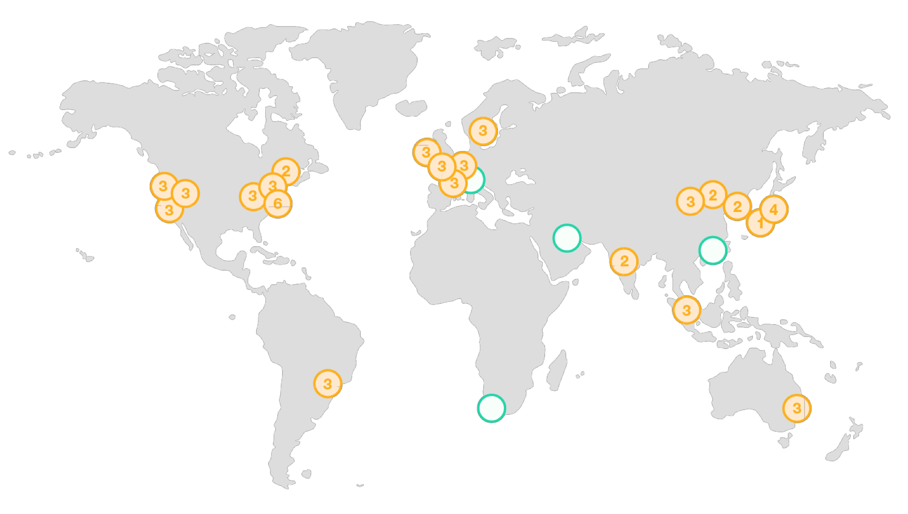








Latency Routing Policy
NOT FOR DISTRIBUTION © Stephane Maarek www.datacumulus.com
Redirect to the server that has the least latency close to us
Super helpful when latency of users is a priority
Latency is evaluated in terms of user to designated AWS Region
Germany may be directed to the US (if that’s the lowest latency)
© Stephane Maarek

Slide 145
Health Checks
NOT FOR DISTRIBUTION © Stephane Maarek www.datacumulus.com
Have X health checks failed => unhealthy (default 3)
After X health checks passed => health (default 3)
Default Health Check Interval: 30s (can set to 10s – higher cost)
About 15 health checkers will check the endpoint health
• => one request every 2 seconds on average
Can have HTTP,TCP and HTTPS health checks (no SSL verification)
Possibility of integrating the health check with CloudWatch
Health checks can be linked to Route53 DNS queries!
© Stephane Maarek

Slide 146




Failover Routing Policy
NOT FOR DISTRIBUTION © Stephane Maarek www.datacumulus.com
Health check
(mandatory)
Primary
DNS Request
Failover
Web browser
Route 53
Secondary (disaster recovery)
© Stephane Maarek

Slide 147
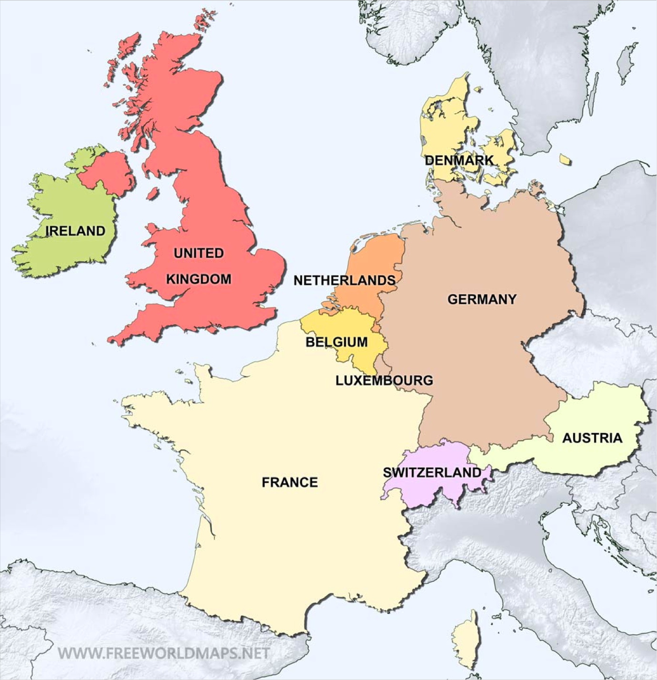
Geo Location Routing Policy
NOT FOR DISTRIBUTION © Stephane Maarek www.datacumulus.com
A: 11.22.33.44
Different from Latency based!
This is routing based on user location
Here we specify: traffic from the UK should go to this specific IP
Should create a “default” policy (in case there’s no match on location)
DEFAULT A:
33.44.55.66
A: 22.33.44.55
© Stephane Maarek

Slide 148
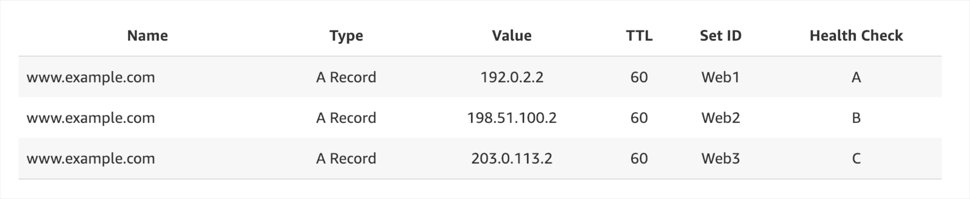
Multi Value Routing Policy
NOT FOR DISTRIBUTION © Stephane Maarek www.datacumulus.com
Use when routing traffic to multiple resources
Want to associate a Route 53 health checks with records
Up to 8 healthy records are returned for each Multi Value query
Multi Value is not a substitute for having an ELB
© Stephane Maarek

Slide 149
Route53 as a Registrar
NOT FOR DISTRIBUTION © Stephane Maarek www.datacumulus.com
A domain name registrar is an organization that manages the reservation of Internet domain names
Famous names:
GoDaddy
Google Domains
Etc…
And also… Route53 (e.g. AWS)!
Domain Registrar != DNS
© Stephane Maarek

Slide 150
3rd Party Registrar with AWS Route 53
NOT FOR DISTRIBUTION © Stephane Maarek www.datacumulus.com
If you buy your domain on 3rd party website, you can still use Route53.
1) Create a Hosted Zone in Route 53
2) Update NS Records on 3rd party website to use Route 53 name servers
Domain Registrar != DNS
(But each domain registrar usually comes with some DNS features)
© Stephane Maarek

Slide 151
Classic Solutions Architecture
NOT FOR DISTRIBUTION © Stephane Maarek www.datacumulus.com
© Stephane Maarek

Slide 152
Section Introduction
NOT FOR DISTRIBUTION © Stephane Maarek www.datacumulus.com
These solutions architectures are the best part of this course
Let’s understand how all the technologies we’ve seen work together
This is a section you need to be 100% comfortable with
We’ll see the progression of a Solution’s architect mindset through many sample case studies:
WhatIsTheTime.Com
MyClothes.Com
MyWordPress.Com
Instantiating applications quickly
Beanstalk
© Stephane Maarek

Slide 153
Stateless Web App: WhatIsTheTime.com
NOT FOR DISTRIBUTION © Stephane Maarek www.datacumulus.com
WhatIsTheTime.com allows people to know what time it is
We don’t need a database
We want to start small and can accept downtime
We want to fully scale vertically and horizontally, no downtime
Let’s go through the Solutions Architect journey for this app
Let’s see how we can proceed!
© Stephane Maarek

Slide 154



Stateless web app: What time is it? Starting simple
NOT FOR DISTRIBUTION © Stephane Maarek www.datacumulus.com
Elastic IP Address
What time is it?
5:30 pm!
User
Public EC2
© Stephane Maarek

Slide 155






Stateless web app: What time is it? Scaling vertically
NOT FOR DISTRIBUTION © Stephane Maarek www.datacumulus.com
What time is it?
Elastic IP Address
7:30 pm!
What time is it?
Downtime while upgrading to M5
5:30 pm!
User
What time is it?
Public EC2
6:30 pm!
© Stephane Maarek

Slide 156









Stateless web app: What time is it? Scaling horizontally
NOT FOR DISTRIBUTION © Stephane Maarek www.datacumulus.com
What time is it?
7:30 pm!
What time is it?
5:30 pm!
User
What time is it?
6:30 pm!
© Stephane Maarek

Slide 157







Stateless web app: What time is it? Scaling horizontally
NOT FOR DISTRIBUTION © Stephane Maarek www.datacumulus.com
DNS Query
For api.whatisthetime.com A Record
TTL 1 hour
What time is it?
Public EC2 instance, No Elastic IP
7:30 pm!
What time is it?
5:30 pm!
What time is it?
6:30 pm!
© Stephane Maarek

Slide 158
Stateless web app: What time is it?
Scaling horizontally, adding and removing instances
NOT FOR DISTRIBUTION © Stephane Maarek www.datacumulus.com
DNS Query
For api.whatisthetime.com A Record
TTL 1 hour
What time is it?
INSTANCE IS GONE!
7:30 pm!
What time is it?
Public EC2 instance, No Elastic IP
5:30 pm!
What time is it?
6:30 pm!
© Stephane Maarek

Slide 159








Stateless web app: What time is it? Scaling horizontally, with a load balancer
NOT FOR DISTRIBUTION © Stephane Maarek www.datacumulus.com
What time is it?
Availability zone 1
Availability zone 1
Restricted
Security groups rules
DNS Query
For api.whatisthetime.com Alias Record
TTL 1 hour
ELB +
Health Checks
Private
EC2 instances
© Stephane Maarek

Slide 160




Stateless web app: What time is it?
Scaling horizontally, with an auto-scaling group
NOT FOR DISTRIBUTION © Stephane Maarek www.datacumulus.com
What time is it?
Availability zone 1
Availability zone 1
Auto Scaling group
DNS Query
For api.whatisthetime.com Alias Record
TTL 1 hour
ELB +
Health Checks
Private
EC2 instances
© Stephane Maarek

Slide 161




Stateless web app: What time is it?
NOT FOR DISTRIBUTION © Stephane Maarek www.datacumulus.com
Making our app multi-AZ
Auto Scaling group
What time is it?
Availability zone 1 to 3
Availability zone 1
Availability zone 2
DNS Query
For api.whatisthetime.com Alias Record
TTL 1 hour
ELB +
Health Checks
+ Multi AZ
Availability zone 3
© Stephane Maarek

Slide 162
Minimum 2 AZ => Let’s reserve capacity
NOT FOR DISTRIBUTION © Stephane Maarek www.datacumulus.com
Auto Scaling group
Availability zone 1 to 3
Availability zone 1
Availability zone 2
DNS Query
For api.whatisthetime.com Alias Record
TTL 1 hour
ELB +
Health Checks
+ Multi AZ
Minimum capacity
= reserved instances
= cost savings
© Stephane Maarek

Slide 163
In this lecture we’ve discussed…
NOT FOR DISTRIBUTION © Stephane Maarek www.datacumulus.com
Public vs Private IP and EC2 instances
Elastic IP vs Route 53 vs Load Balancers
Route 53 TTL, A records and Alias Records
Maintaining EC2 instances manually vs Auto Scaling Groups
Multi AZ to survive disasters
ELB Health Checks
Security Group Rules
Reservation of capacity for costing savings when possible
We’re considering 5 pillars for a well architected application: costs, performance, reliability, security, operational excellence
© Stephane Maarek

Slide 164
Stateful Web App: MyClothes.com
NOT FOR DISTRIBUTION © Stephane Maarek www.datacumulus.com
MyClothes.com allows people to buy clothes online.
There’s a shopping cart
Our website is having hundreds of users at the same time
We need to scale, maintain horizontal scalability and keep our web application as stateless as possible
Users should not lose their shopping cart
Users should have their details (address, etc) in a database
Let’s see how we can proceed!
© Stephane Maarek

Slide 165







Stateful Web App: MyClothes.com
NOT FOR DISTRIBUTION © Stephane Maarek www.datacumulus.com
Auto Scaling group
Availability zone 1
Multi AZ
Availability zone 2
Availability zone 3
© Stephane Maarek

Slide 166
Stateful Web App: MyClothes.com Introduce Stickiness (Session Affinity)
NOT FOR DISTRIBUTION © Stephane Maarek www.datacumulus.com
Auto Scaling group
Availability zone 1
Multi AZ
Availability zone 2
ELB Stickiness
Availability zone 3
© Stephane Maarek

Slide 167
Stateful Web App: MyClothes.com Introduce User Cookies
NOT FOR DISTRIBUTION © Stephane Maarek www.datacumulus.com
Auto Scaling group
Availability zone 1
Multi AZ
Send shopping cart content in Web Cookies
Stateless
HTTP requests are heavier Security risk
(cookies can be altered) Cookies must be validated Cookies must be less than 4KB
Availability zone 2
Availability zone 3
© Stephane Maarek

Slide 168


Stateful Web App: MyClothes.com Introduce Server Session
NOT FOR DISTRIBUTION © Stephane Maarek www.datacumulus.com
ElastiCache
Auto Scaling group
Availability zone 1
Multi AZ
Send session_id in Web Cookies
Availability zone 2
Store / retrieve session data
Availability zone 3
Amazon DynamoDB (alternative)
© Stephane Maarek

Slide 169

Stateful Web App: MyClothes.com Storing User Data in a database
NOT FOR DISTRIBUTION © Stephane Maarek www.datacumulus.com
ElastiCache
Auto Scaling group
Availability zone 1
Multi AZ
Availability zone 2
Store / retrieve user data (address, name, etc)
Availability zone 3
Amazon RDS
© Stephane Maarek

Slide 170


Stateful Web App: MyClothes.com Scaling Reads
NOT FOR DISTRIBUTION © Stephane Maarek www.datacumulus.com
ElastiCache
Auto Scaling group
Availability zone 1
Multi AZ
Availability zone 2
RDS
Master (writes)
replication
Availability zone 3
RDS
Read Replicas
© Stephane Maarek

Slide 171

Stateful Web App: MyClothes.com
Scaling Reads (Alternative) – Write Through
NOT FOR DISTRIBUTION © Stephane Maarek www.datacumulus.com
ElastiCache
Auto Scaling group
Availability zone 1
cache
Multi AZ
hit
Availability zone 2
Read from cache
Read/write
Availability zone 3
RDS
© Stephane Maarek

Slide 172
Stateful Web App: MyClothes.com Multi AZ – Survive disasters
NOT FOR DISTRIBUTION © Stephane Maarek www.datacumulus.com
ElastiCache Multi AZ
Auto Scaling group
Availability zone 1
Multi AZ
Availability zone 2
Availability zone 3
RDS
Multi AZ
© Stephane Maarek

Slide 173
Stateful Web App: MyClothes.com Security Groups
NOT FOR DISTRIBUTION © Stephane Maarek www.datacumulus.com
Restrict traffic to ElastiCache Security group from the
EC2 security group
Auto Scaling group
Availability zone 1
ElastiCache
Multi AZ
Open HTTP / HTTPS to 0.0.0.0/0
Availability zone 2
RDS
Availability zone 3
Restrict traffic to RDS Security group from the EC2 security group
Restrict traffic to EC2
Security group from the LB
© Stephane Maarek

Slide 174
In this lecture we’ve discussed…
3-tier architectures for web applications
NOT FOR DISTRIBUTION © Stephane Maarek www.datacumulus.com
ELB sticky sessions
Web clients for storing cookies and making our web app stateless
ElastiCache
For storing sessions (alternative: DynamoDB)
For caching data from RDS
Multi AZ
RDS
For storing user data
Read replicas for scaling reads
Multi AZ for disaster recovery
Tight Security with security groups referencing each other
© Stephane Maarek

Slide 175
Stateful Web App: MyWordPress.com
NOT FOR DISTRIBUTION © Stephane Maarek www.datacumulus.com
We are trying to create a fully scalable WordPress website
We want that website to access and correctly display picture uploads
Our user data, and the blog content should be stored in a MySQL database.
Let’s see how we can achieve this!
© Stephane Maarek

Slide 176

Stateful Web App: MyWordPress.com RDS layer
NOT FOR DISTRIBUTION © Stephane Maarek www.datacumulus.com
Auto Scaling group
Availability zone 1
Multi AZ
Availability zone 2
RDS
Multi AZ
Availability zone 3
© Stephane Maarek

Slide 177

Stateful Web App: MyWordPress.com
Scaling with Aurora: Multi AZ & Read Replicas
NOT FOR DISTRIBUTION © Stephane Maarek www.datacumulus.com
Auto Scaling group
Availability zone 1
Multi AZ
Availability zone 2
Aurora MySQL Multi AZ
Read Replicas
Availability zone 3
© Stephane Maarek

Slide 178


Stateful Web App: MyWordPress.com Storing images with EBS
NOT FOR DISTRIBUTION © Stephane Maarek www.datacumulus.com
Multi AZ
Availability zone 1
Amazon EBS Volume
Send image
© Stephane Maarek

Slide 179




Stateful Web App: MyWordPress.com Storing images with EBS
NOT FOR DISTRIBUTION © Stephane Maarek www.datacumulus.com
Availability zone 1
Amazon EBS Volume
Multi AZ
Send image
Availability zone 2
Amazon EBS Volume
© Stephane Maarek

Slide 180




Stateful Web App: MyWordPress.com Storing images with EFS
NOT FOR DISTRIBUTION © Stephane Maarek www.datacumulus.com
Availability zone 1
Multi AZ
ENI
Send image
Availability zone 2
EFS
ENI
© Stephane Maarek

Slide 181
In this lecture we’ve discussed…
NOT FOR DISTRIBUTION © Stephane Maarek www.datacumulus.com
Aurora Database to have easy Multi-AZ and Read-Replicas
Storing data in EBS (single instance application)
Vs Storing data in EFS (distributed application)
© Stephane Maarek

Slide 182
Instantiating Applications quickly
NOT FOR DISTRIBUTION © Stephane Maarek www.datacumulus.com
When launching a full stack (EC2, EBS, RDS), it can take time to:
Install applications
Insert initial (or recovery) data
Configure everything
Launch the application
We can take advantage of the cloud to speed that up!
© Stephane Maarek

Slide 183
Instantiating Applications quickly
NOT FOR DISTRIBUTION © Stephane Maarek www.datacumulus.com
EC2 Instances:
Use a Golden AMI: Install your applications, OS dependencies etc.. beforehand and launch your EC2 instance from the Golden AMI
Bootstrap using User Data: For dynamic configuration, use User Data scripts
Hybrid: mix Golden AMI and User Data (Elastic Beanstalk)
RDS Databases:
Restore from a snapshot: the database will have schemas and data ready!
EBS Volumes:
Restore from a snapshot: the disk will already be formatted and have data!
© Stephane Maarek

Slide 184
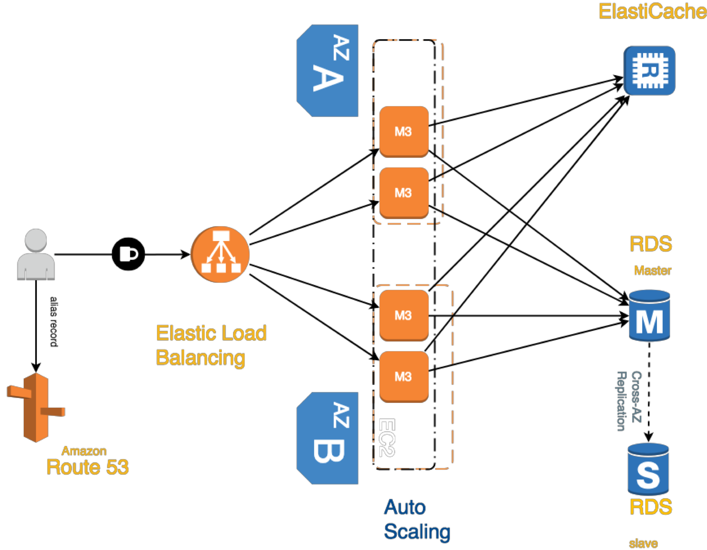
Typical architecture Web App 3-tier
NOT FOR DISTRIBUTION © Stephane Maarek www.datacumulus.com
Data / Private Subnet
Private Subnet
Public Subnet
© Stephane Maarek

Slide 185
Developer problems on AWS
NOT FOR DISTRIBUTION © Stephane Maarek www.datacumulus.com
Managing infrastructure
Deploying Code
Configuring all the databases, load balancers, etc
Scaling concerns
Most web apps have the same architecture (ALB + ASG)
All the developers want is for their code to run!
Possibly, consistently across different applications and environments
© Stephane Maarek

Slide 186

AWS Elastic Beanstalk Overview
NOT FOR DISTRIBUTION © Stephane Maarek www.datacumulus.com
Elastic Beanstalk is a developer centric view of deploying an application on AWS
It uses all the component’s we’ve seen before: EC2, ASG, ELB, RDS, etc…
But it’s all in one view that’s easy to make sense of!
We still have full control over the configuration
Beanstalk is free but you pay for the underlying instances
© Stephane Maarek

Slide 187
Elastic Beanstalk
NOT FOR DISTRIBUTION © Stephane Maarek www.datacumulus.com
Managed service
Instance configuration / OS is handled by Beanstalk
Deployment strategy is configurable but performed by Elastic Beanstalk
Just the application code is the responsibility of the developer
Three architecture models:
Single Instance deployment: good for dev
LB + ASG: great for production or pre-production web applications
ASG only: great for non-web apps in production (workers, etc..)
© Stephane Maarek

Slide 188
Elastic Beanstalk
NOT FOR DISTRIBUTION © Stephane Maarek www.datacumulus.com
Elastic Beanstalk has three components
Application
Application version: each deployment gets assigned a version
Environment name (dev, test, prod…): free naming
You deploy application versions to environments and can promote application versions to the next environment
Rollback feature to previous application version
Full control over lifecycle of environments
Create Application
Upload Version (+ alias)
Release to environments
Create Environments
© Stephane Maarek

Slide 189
Elastic Beanstalk
NOT FOR DISTRIBUTION © Stephane Maarek www.datacumulus.com
Support for many platforms:
Go
Java SE
Java with Tomcat
.NET on Windows Server with IIS
Node.js
PHP
Python
Ruby
Packer Builder
Single Container Docker
Multicontainer Docker
Preconfigured Docker
If not supported, you can write your custom platform (advanced)
© Stephane Maarek

Slide 190
NOT FOR DISTRIBUTION © Stephane Maarek www.datacumulus.com
S3 Storage and Data Management
S3, Glacier, Athena, Snowball, Snowball Edge and Storage Gateway
© Stephane Maarek

Slide 191
S3 Section
NOT FOR DISTRIBUTION © Stephane Maarek www.datacumulus.com
Two parts:
1st part: S3 Fundamentals (from developer course)
Bucket & Objects
Versioning
Security – Encryption & Bucket Policies
Websites
CORS
Consistency Model
2nd part: S3 for SysOps
© Stephane Maarek

Slide 192

Section introduction
NOT FOR DISTRIBUTION © Stephane Maarek www.datacumulus.com
Amazon S3 is one of the main building blocks of AWS
It’s advertised as ”infinitely scaling” storage
It’s widely popular and deserves its own section
Many websites use AWS S3 as a backbone
Many AWS services uses AWS S3 as an integration as well
We’ll have a step-by-step approach to S3
© Stephane Maarek

Slide 193

AWS S3 Overview - Buckets
NOT FOR DISTRIBUTION © Stephane Maarek www.datacumulus.com
Amazon S3 allows people to store objects (files) in “buckets” (directories)
Buckets must have a globally unique name
Buckets are defined at the region level
Naming convention
No uppercase
No underscore
3-63 characters long
Not an IP
Must start with lowercase letter or number
© Stephane Maarek

Slide 194

AWS S3 Overview - Objects
NOT FOR DISTRIBUTION © Stephane Maarek www.datacumulus.com
Objects (files) have a Key.The key is the FULL path:
<my_bucket>/my_file.txt
<my_bucket>/my_folder1/another_folder/my_file.txt
There’s no concept of “directories” within buckets (although the UI will trick you to think otherwise)
Just keys with very long names that contain slashes (“/”)
Object Values are the content of the body:
Max Size is 5TB
If uploading more than 5GB, must use “multi-part upload”
Metadata (list of text key / value pairs – system or user metadata)
Tags (Unicode key / value pair – up to 10) – useful for security / lifecycle
Version ID (if versioning is enabled)
© Stephane Maarek

Slide 195

AWS S3 - Versioning
NOT FOR DISTRIBUTION © Stephane Maarek www.datacumulus.com
You can version your files in AWS S3
It is enabled at the bucket level
Same key overwrite will increment the “version”: 1, 2, 3….
It is best practice to version your buckets
Protect against unintended deletes (ability to restore a version)
Easy roll back to previous version
Any file that is not versioned prior to enabling versioning will have version “null”
© Stephane Maarek

Slide 196
S3 Encryption for Objects
NOT FOR DISTRIBUTION © Stephane Maarek www.datacumulus.com
There are 4 methods of encrypting objects in S3
SSE-S3: encrypts S3 objects using keys handled & managed by AWS
SSE-KMS: leverage AWS Key Management Service to manage encryption keys
SSE-C: when you want to manage your own encryption keys
Client Side Encryption
It’s important to understand which ones are adapted to which situation for the exam
© Stephane Maarek

Slide 197




SSE-S3
NOT FOR DISTRIBUTION © Stephane Maarek www.datacumulus.com
SSE-S3: encryption using keys handled & managed by AWS S3
Object is encrypted server side
AES-256 encryption type
Must set header: “x-amz-server-side-encryption": "AES256"
Object
AWS S3
Object
HTTP/S + Header
+
encryption
Bucket
S3 Managed Data Key
© Stephane Maarek

Slide 198

SSE-KMS
NOT FOR DISTRIBUTION © Stephane Maarek www.datacumulus.com
SSE-KMS: encryption using keys handled & managed by KMS
KMS Advantages: user control + audit trail
Object is encrypted server side
Must set header: “x-amz-server-side-encryption": ”aws:kms"
Object
AWS S3
Object
HTTP/S + Header
+
encryption
Bucket
KMS Customer Master Key (CMK)
© Stephane Maarek

Slide 199


SSE-C
NOT FOR DISTRIBUTION © Stephane Maarek www.datacumulus.com
SSE-C: server-side encryption using data keys fully managed by the customer outside of AWS
Amazon S3 does not store the encryption key you provide
HTTPS must be used
Encryption key must provided in HTTP headers, for every HTTP request made
Object
Object
AWS S3
HTTPS only +
Data Key in Header
+
+
encryption
Bucket
Client side data key
Client-provided data key
© Stephane Maarek

Slide 200





Client Side Encryption
NOT FOR DISTRIBUTION © Stephane Maarek www.datacumulus.com
Client library such as the Amazon S3 Encryption Client
Clients must encrypt data themselves before sending to S3
Clients must decrypt data themselves when retrieving from S3
Customer fully manages the keys and encryption cycle
Client - S3 Encryption SDK
Object
AWS S3
Bucket
HTTP/S
+
encryption
Client side data key
© Stephane Maarek

Slide 201
Encryption in transit (SSL)
NOT FOR DISTRIBUTION © Stephane Maarek www.datacumulus.com
AWS S3 exposes:
HTTP endpoint: non encrypted
HTTPS endpoint: encryption in flight
You’re free to use the endpoint you want, but HTTPS is recommended
HTTPS is mandatory for SSE-C
Encryption in flight is also called SSL / TLS
© Stephane Maarek

Slide 202
S3 Security
NOT FOR DISTRIBUTION © Stephane Maarek www.datacumulus.com
User based
IAM policies - which API calls should be allowed for a specific user from IAM console
Resource Based
Bucket Policies - bucket wide rules from the S3 console - allows cross account
Object Access Control List (ACL) – finer grain
Bucket Access Control List (ACL) – less common
© Stephane Maarek

Slide 203
S3 Bucket Policies
NOT FOR DISTRIBUTION © Stephane Maarek www.datacumulus.com
JSON based policies
Resources: buckets and objects
Actions: Set of API to Allow or Deny
Effect: Allow / Deny
Principal:The account or user to apply the policy to
Use S3 bucket for policy to:
Grant public access to the bucket
Force objects to be encrypted at upload
Grant access to another account (Cross Account)
© Stephane Maarek

Slide 204
S3 Security - Other
NOT FOR DISTRIBUTION © Stephane Maarek www.datacumulus.com
Networking:
Supports VPC Endpoints (for instances in VPC without www internet)
Logging and Audit:
S3 access logs can be stored in other S3 bucket
API calls can be logged in AWS CloudTrail
User Security:
MFA (multi factor authentication) can be required in versioned buckets to delete objects
Signed URLs: URLs that are valid only for a limited time (ex: premium video service for logged in users)
© Stephane Maarek

Slide 205
S3 Websites
NOT FOR DISTRIBUTION © Stephane Maarek www.datacumulus.com
S3 can host static websites and have them accessible on the www
The website URL will be:
<bucket-name>.s3-website-<AWS-region>.amazonaws.com
OR
<bucket-name>.s3-website.<AWS-region>.amazonaws.com
If you get a 403 (Forbidden) error, make sure the bucket policy allows public reads!
© Stephane Maarek

Slide 206


S3 CORS
NOT FOR DISTRIBUTION © Stephane Maarek www.datacumulus.com
If you request data from another S3 bucket, you need to enable CORS
Cross Origin Resource Sharing allows you to limit the number of websites that can request your files in S3 (and limit your costs)
It’s a popular exam question
GET index.html
Client
GET coffee.jpg
mybucket
ORIGIN: http://mybucket.s3-website.eu-west-3.amazonaws.com/
Access-Control-Allow-Origin: <domain>
myimagebucket
© Stephane Maarek

Slide 207
AWS S3 - Consistency Model
NOT FOR DISTRIBUTION © Stephane Maarek www.datacumulus.com
Read after write consistency for PUTS of new objects
As soon as an object is written, we can retrieve it ex: (PUT 200 -> GET 200)
This is true, except if we did a GET before to see if the object existed ex: (GET 404 -> PUT 200 -> GET 404) – eventually consistent
Eventual Consistency for DELETES and PUTS of existing objects
If we read an object after updating, we might get the older version ex: (PUT 200 -> PUT 200 -> GET 200 (might be older version))
If we delete an object, we might still be able to retrieve it for a short time ex: (DELETE 200 -> GET 200)
© Stephane Maarek

Slide 208
Developing on AWS
NOT FOR DISTRIBUTION © Stephane Maarek www.datacumulus.com
© Stephane Maarek

Slide 209
Section Introduction
NOT FOR DISTRIBUTION © Stephane Maarek www.datacumulus.com
So far, we’ve interacts with services manually and they exposed standard information for clients:
EC2 exposes a standard Linux machine we can use any way we want
RDS exposes a standard database we can connect to using a URL
ElastiCache exposes a cache URL we can connect to using a URL
ASG / ELB are automated and we don’t have to program against them
Route53 was setup manual
Developing against AWS has two components:
How to perform interactions with AWS without using the Online Console?
How to interact with AWS Proprietary services? (S3, DynamoDB, etc…)
© Stephane Maarek

Slide 210
Section Introduction
NOT FOR DISTRIBUTION © Stephane Maarek www.datacumulus.com
Developing and performing AWS tasks against AWS can be done in several ways
Using the AWS CLI on our local computer
Using the AWS CLI on our EC2 machines
Using the AWS SDK on our local computer
Using the AWS SDK on our EC2 machines
Using the AWS Instance Metadata Service for EC2
In this section, we’ll learn:
How to do all of those
In the right & most secure way, adhering to best practices
© Stephane Maarek

Slide 211
AWS CLI Setup Windows
NOT FOR DISTRIBUTION © Stephane Maarek www.datacumulus.com
We’ll setup the CLI properly on Windows
© Stephane Maarek

Slide 212
AWS CLI Setup Mac OS X
NOT FOR DISTRIBUTION © Stephane Maarek www.datacumulus.com
We’ll setup the CLI properly on Mac OS X
© Stephane Maarek

Slide 213
AWS CLI Setup Linux
NOT FOR DISTRIBUTION © Stephane Maarek www.datacumulus.com
We’ll setup the CLI properly on Linux
© Stephane Maarek

Slide 214
AWS CLI Configuration
NOT FOR DISTRIBUTION © Stephane Maarek www.datacumulus.com
Let’s learn how to properly configure the CLI
AWS NETWORK
Computer
AWS Account
(checks credentials and permissions)
CLI access over www
We’ll learn how to get our access credentials and protect them
Do not share your AWS Access Key and Secret key with anyone!
© Stephane Maarek

Slide 215
AWS CLI ON EC2… THE BAD WAY
NOT FOR DISTRIBUTION © Stephane Maarek www.datacumulus.com
We could run `aws configure` on EC2 just like we did (and it’ll work)
But… it’s SUPER INSECURE
NEVER EVER EVER PUT YOUR PERSONAL CREDENTIALS ON AN EC2
Your PERSONAL credentials are PERSONAL and only belong on your
PERSONAL computer
If the EC2 is compromised, so is your personal account
If the EC2 is shared, other people may perform AWS actions while impersonating you
For EC2, there’s a better way… it’s called AWS IAM Roles
© Stephane Maarek

Slide 216
AWS CLI ON EC2… THE RIGHT WAY
NOT FOR DISTRIBUTION © Stephane Maarek www.datacumulus.com
IAM Roles can be attached to EC2 instances
IAM Roles can come with a policy authorizing exactly what the EC2 instance should be able to do
AWS NETWORK
CLI
EC2 Instance IAM ROLE
AWS Account
(checks credentials and permissions of the ROLE)
EC2 Instances can then use these profiles automatically without any additional configurations
This is the best practice on AWS and you should 100% do this.
© Stephane Maarek

Slide 217
AWS EC2 Instance Metadata
NOT FOR DISTRIBUTION © Stephane Maarek www.datacumulus.com
AWS EC2 Instance Metadata is powerful but one of the least known features to developers
It allows AWS EC2 instances to ”learn about themselves” without using an IAM Role for that purpose.
The URL is http://169.254.169.254/latest/meta-data
You can retrieve the IAM Role name from the metadata, but you CANNOT retrieve the IAM Policy.
Metadata = Info about the EC2 instance
Userdata = launch script of the EC2 instance
Let’s practice and see what we can do with it!
© Stephane Maarek

Slide 218
AWS SDK Overview
NOT FOR DISTRIBUTION © Stephane Maarek www.datacumulus.com
What if you want to perform actions on AWS directly from your applications code ? (without using the CLI).
You can use an SDK (software development kit) !
Official SDKs are…
Java
.NET
Node.js
PHP
Python (named boto3 / botocore)
Go
Ruby
C++
© Stephane Maarek

Slide 219
AWS SDK Overview
NOT FOR DISTRIBUTION © Stephane Maarek www.datacumulus.com
We have to use the AWS SDK when coding against AWS Services such as DynamoDB
Fun fact… the AWS CLI uses the Python SDK (boto3)
The exam expects you to know when you should use an SDK
We’ll practice the AWS SDK when we get to the Lambda functions
Good to know: if you don’t specify or configure a default region, then us-east-1 will be chosen by default
© Stephane Maarek

Slide 220
AWS SDK Credentials Security
NOT FOR DISTRIBUTION © Stephane Maarek www.datacumulus.com
It’s recommend to use the default credential provider chain
The default credential provider chain works seamlessly with:
AWS credentials at ~/.aws/credentials (only on our computers or on premise)
Instance Profile Credentials using IAM Roles (for EC2 machines, etc…)
Environment variables (AWS_ACCESS_KEY_ID, AWS_SECRET_ACCESS_KEY)
Overall, NEVER EVER STORE AWS CREDENTIALS IN YOUR CODE.
Best practice is for credentials to be inherited from mechanisms above, and 100% IAM Roles if working from within AWS Services
© Stephane Maarek

Slide 221
Exponential Backoff
NOT FOR DISTRIBUTION © Stephane Maarek www.datacumulus.com
Any API that fails because of too many calls needs to be retried with Exponential Backoff
These apply to rate limited API
Retry mechanism included in SDK API calls
1
2
3
4
5
© Stephane Maarek

Slide 222
NOT FOR DISTRIBUTION © Stephane Maarek www.datacumulus.com
Advanced S3
S3, CloudFront, Glacier, Athena, Snowball, Snowball Edge and Storage Gateway
© Stephane Maarek

Slide 223
S3 MFA-Delete
NOT FOR DISTRIBUTION © Stephane Maarek www.datacumulus.com
MFA (multi factor authentication) forces user to generate a code on a device (usually a mobile phone or hardware) before doing important operations on S3
To use MFA-Delete, enable Versioning on the S3 bucket
You will need MFA to
permanently delete an object version
suspend versioning on the bucket
You won’t need MFA for
enabling versioning
listing deleted versions
Only the bucket owner (root account) can enable/disable MFA-Delete
MFA-Delete currently can only be enabled using the CLI
© Stephane Maarek

Slide 224
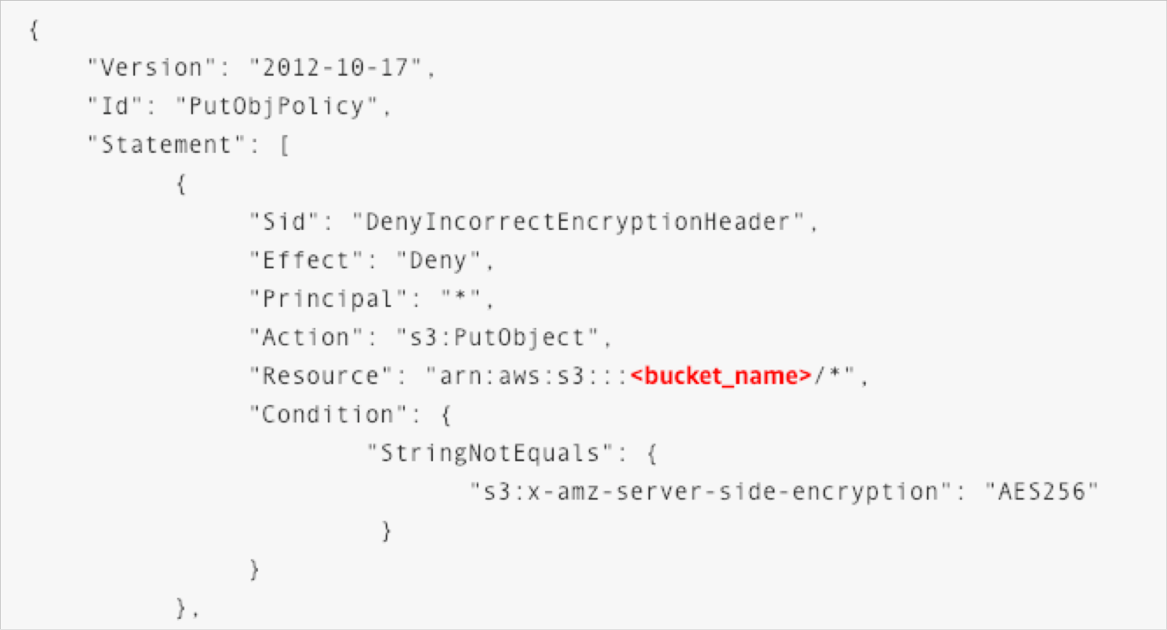
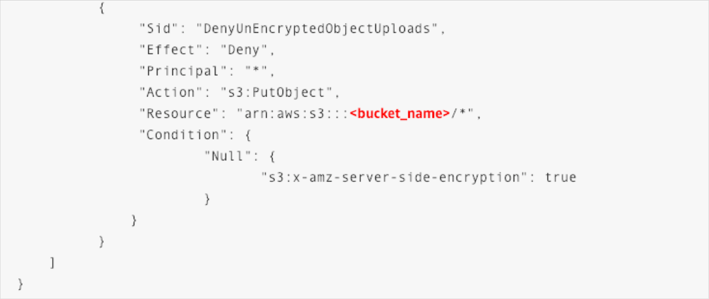
S3 Default Encryption vs Bucket Policies
NOT FOR DISTRIBUTION © Stephane Maarek www.datacumulus.com
The old way to enable default encryption was to use a bucket policy and refuse any HTTP command without the proper headers:
The new way is to use the “default encryption” option in S3
Note: Bucket Policies are evaluated before “default encryption”
© Stephane Maarek

Slide 225



S3 Access Logs
NOT FOR DISTRIBUTION © Stephane Maarek www.datacumulus.com
user
For audit purpose, you may want to log all access to S3 buckets
Any request made to S3, from any account, authorized or denied, will be logged into another S3 bucket
That data can be analyzed using data analysis tools…
Or Amazon Athena as we’ll see later in this section!
requests
My-bucket
Log all requests
The log format is at: https://docs.aws.amazon.com/AmazonS3/latest/dev/LogFo rmat.html
Logging Bucket
© Stephane Maarek

Slide 226


S3 Cross Region Replication
NOT FOR DISTRIBUTION © Stephane Maarek www.datacumulus.com
Must enable versioning (source and destination)
Buckets must be in different AWS regions
Can be in different accounts
Copying is asynchronous
Must give proper IAM permissions to S3
Asynchronous replication
eu-west-1
us-east-1
Use cases: compliance, lower latency access, replication across accounts
© Stephane Maarek

Slide 227
S3 pre-signed URLs
NOT FOR DISTRIBUTION © Stephane Maarek www.datacumulus.com
Can generate pre-signed URLs using SDK or CLI
For downloads (easy, can use the CLI)
For uploads (harder, must use the SDK)
Valid for a default of 3600 seconds, can change timeout with --expires-in [TIME_BY_SECONDS] argument
Users given a pre-signed URL inherit the permissions of the person who generated the URL for GET / PUT
Examples :
Allow only logged-in users to download a premium video on your S3 bucket
Allow an ever changing list of users to download files by generating URLs dynamically
Allow temporarily a user to upload a file to a precise location in our bucket
© Stephane Maarek

Slide 228
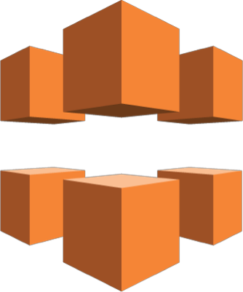
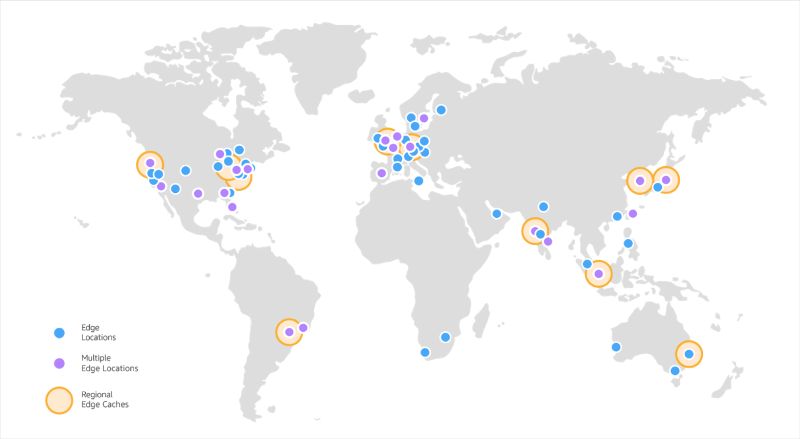



AWS CloudFront
NOT FOR DISTRIBUTION © Stephane Maarek www.datacumulus.com
Content Delivery Network (CDN)
Improves read performance, content is cached at the edge
136 Point of Presence globally (edge locations)
Popular with S3 but works with EC2, Load Balancing
Can help protect against network attacks
Can provide SSL encryption (HTTPS) at the edge using ACM
CloudFront can use SSL encryption (HTTPS) to talk to your applications
Support RTMP Protocol (videos / media)
Source: https://aws.amazon.com/cloudfront/features/?nc=sn&loc=2
© Stephane Maarek

Slide 229
AWS CloudFront Hands On
NOT FOR DISTRIBUTION © Stephane Maarek www.datacumulus.com
We’ll create an S3 bucket
We’ll create a CloudFront distribution
We’ll create an Origin Access Identity
We’ll limit the S3 bucket to be accessed only using this identity
© Stephane Maarek

Slide 230
CloudFront Signed URL / Signed Cookies
NOT FOR DISTRIBUTION © Stephane Maarek www.datacumulus.com
Say you wanted to distribute paid shared content to premium users over the world, the content lives in S3.
If S3 can only be accessed through CloudFront, we cannot used self-signed S3 URLs.
We can use CloudFront Signed URL. We attach a policy with:
Includes URL expiration
Includes IP ranges to access the data from
Trusted signers (which AWS accounts can create signed URLs)
CloudFront signed URL can only be created using the AWS SDK, so you have to code an application to verify users and generate these URLs
How long should the URL be valid for?
Shared content (movie, music): make it short (a few minutes)
Private content (private to the user): you can make it last for years
© Stephane Maarek

Slide 231







CloudFront Signed URL Diagram
NOT FOR DISTRIBUTION © Stephane Maarek www.datacumulus.com
Amazon CloudFront
Amazon S3
Signed URL
OAI
Client
Object
Edge location
Return Signed URL
Authentication
+ Authorization
Edge location
Use AWS SDK
Generate Signed URL
Application
© Stephane Maarek

Slide 232
CloudFront vs S3 Cross Region Replication
NOT FOR DISTRIBUTION © Stephane Maarek www.datacumulus.com
CloudFront:
Global Edge network
Files are cached for a TTL (maybe a day)
Great for static content that must be available everywhere
S3 Cross Region Replication:
Must be setup for each region you want replication to happen
Files are updated in near real-time
Read only
Great for dynamic content that needs to be available at low-latency in few regions
© Stephane Maarek

Slide 233
S3 Storage Tiers
NOT FOR DISTRIBUTION © Stephane Maarek www.datacumulus.com
Amazon S3 Standard - General Purpose
Amazon S3 Standard-Infrequent Access (IA)
Amazon S3 One Zone-Infrequent Access
Amazon S3 Reduced Redundancy Storage (deprecated)
Amazon S3 Intelligent Tiering (new!)
Amazon Glacier
© Stephane Maarek

Slide 234
S3 Standard – General Purpose
NOT FOR DISTRIBUTION © Stephane Maarek www.datacumulus.com
High durability (99.999999999%) of objects across multiple AZ
If you store 10,000,000 objects with Amazon S3, you can on average expect to incur a loss of a single object once every 10,000 years
99.99% Availability over a given year
Sustain 2 concurrent facility failures
Use Cases: Big Data analytics, mobile & gaming applications, content distribution…
© Stephane Maarek

Slide 235
S3 Reduced Redundancy Storage (RRS) - DEPRECATED
NOT FOR DISTRIBUTION © Stephane Maarek www.datacumulus.com
Designed to provide 99.99% durability
99.99% availability of objects over a given year
Designed to sustain the loss of data in a single facility
Use cases: noncritical, reproducible data at lower levels of redundancy than Amazon S3’s standard storage (thumbnails, transcoded media, processed data that can be reproduced)
© Stephane Maarek

Slide 236
S3 Standard – Infrequent Access (IA)
NOT FOR DISTRIBUTION © Stephane Maarek www.datacumulus.com
Suitable for data that is less frequently accessed, but requires rapid access when needed
High durability (99.999999999%) of objects across multiple AZs
99.99% Availability
Low cost compared to Amazon S3 Standard
Sustain 2 concurrent facility failures
Use Cases: As a data store for disaster recovery, backups…
© Stephane Maarek

Slide 237
S3 One Zone - Infrequent Access (IA)
NOT FOR DISTRIBUTION © Stephane Maarek www.datacumulus.com
Same as IA but data is stored in a single AZ
High durability (99.999999999%) of objects in a single AZ; data lost when AZ is destroyed
99.95% Availability
Low latency and high throughput performance
Supports SSL for data at transit and encryption at rest
Low cost compared to IA (by 20%)
Use Cases: Storing secondary backup copies of on-premise data, or storing data you can recreate
© Stephane Maarek

Slide 238
S3 Intelligent Tiering (new!)
NOT FOR DISTRIBUTION © Stephane Maarek www.datacumulus.com
Probably not at the exam (yet!)
Same low latency and high throughput performance of S3 Standard
Small monthly monitoring and auto-tiering fee
Automatically moves objects between two access tiers based on changing access patterns
Designed for durability of 99.999999999% of objects across multiple Availability Zones
Resilient against events that impact an entire Availability Zone
Designed for 99.9% availability over a given year
© Stephane Maarek

Slide 239
S3 Glacier
NOT FOR DISTRIBUTION © Stephane Maarek www.datacumulus.com
Low cost object storage meant for archiving / backup
Data is retained for the longer term (10s of years)
Alternative to on-premise magnetic tape storage
Average annual durability is 99.999999999%
Cost per storage per month ($0.004 / GB) + retrieval cost
Each item in Glacier is called “Archive” (up to 40TB)
Archives are stored in ”Vaults”
3 retrieval options:
Expedited (1 to 5 minutes retrieval) – $0.03 per GB and $0.01 per request
Standard (3 to 5 hours) - $0.01 per GB and 0.05 per 1000 requests
Bulk (5 to 12 hours) - $0.0025 per GB and $0.025 per 1000 requests
© Stephane Maarek

Slide 240
S3 Storage Tiers Comparison
NOT FOR DISTRIBUTION © Stephane Maarek www.datacumulus.com
 | Standard | Reduced Redundancy Storage | Standard - Infrequent Access | One - Infrequent Access | S3 Intelligent- Tiering | Glacier
Durability | 99.999999999% | 99.99% | 99.999999999% | 99.999999999% | 99.999999999% | 99.999999999%
Availability | 99.99% | 99.99% | 99.9% | 99.5% | 99.90% | NA
AZ | ≥3 | ≥2 | ≥3 | 1 | ≥3 | ≥3
Concurrent facility fault tolerance | 2 | 1 | 2 | 0 | 1 | 1
Frequently accessed
Infrequently accessed
Intelligent (new!)
Archives
© Stephane Maarek

Slide 241
S3 Lifecycle Rules
NOT FOR DISTRIBUTION © Stephane Maarek www.datacumulus.com
Set of rules to move data between different tiers, to save storage cost
Example: General Purpose => Infrequent Access => Glacier
Transition actions: It defines when objects are transitioned to another storage
class.
Eg: We can choose to move objects to Standard IA class 60 days after you created them or can move to Glacier for archiving after 6 months
Expiration actions: Helps to configure objects to expire after a certain time
period. S3 deletes expired objects on our behalf
Eg: Access log files can be set to delete after a specified period of time
Can be used to delete incomplete multi-part uploads!
© Stephane Maarek

Slide 242
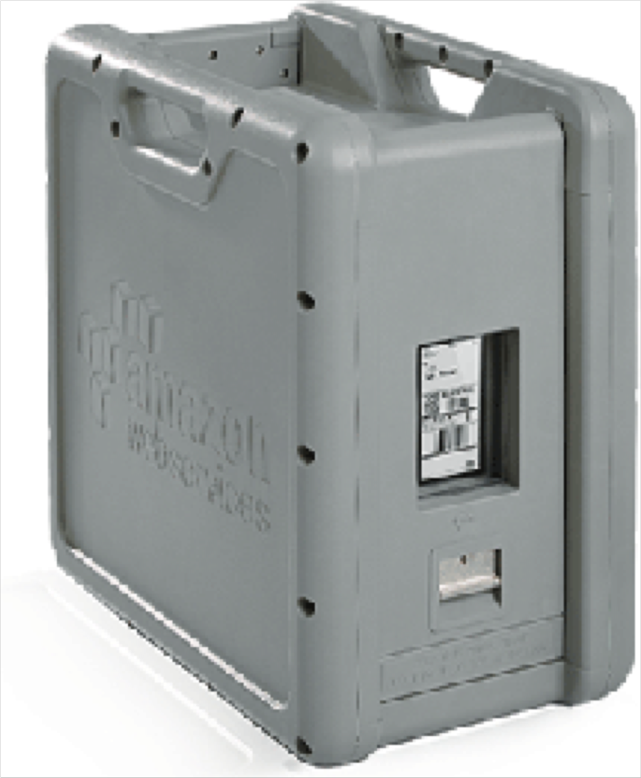
Snowball
NOT FOR DISTRIBUTION © Stephane Maarek www.datacumulus.com
Physical data transport solution that helps moving TBs or PBs of data in or out of AWS
Alternative to moving data over the network (and paying network fees)
Secure, tamper resistant, uses KMS 256 bit encryption
Tracking using SNS and text messages. E-ink shipping label
Pay per data transfer job
Use cases: large data cloud migrations, DC decommission, disaster recovery
If it takes more than a week to transfer over the network, use Snowball devices!
© Stephane Maarek

Slide 243
Snowball Process
NOT FOR DISTRIBUTION © Stephane Maarek www.datacumulus.com
Request snowball devices from the AWS console for delivery
Install the snowball client on your servers
Connect the snowball to your servers and copy files using the client
Ship back the device when you’re done (goes to the right AWS facility)
Data will be loaded into an S3 bucket
Snowball is completely wiped
Tracking is done using SNS, text messages and the AWS console
© Stephane Maarek

Slide 244







Diagrams
NOT FOR DISTRIBUTION © Stephane Maarek www.datacumulus.com
Direct upload to S3:
www: 10Gbit/s
client
Amazon S3 bucket
With snowball
ship
AWS
Snowball
AWS
Snowball
import/ export
client
Amazon S3 bucket
© Stephane Maarek

Slide 245


Snowball Edge
NOT FOR DISTRIBUTION © Stephane Maarek www.datacumulus.com
AMI
Snowball Edges add computational capability to the device
100 TB capacity with either:
Storage optimized – 24 vCPU
Compute optimized – 52 vCPU & optional GPU
Supports a custom EC2 AMI so you can perform processing on the go
Supports custom Lambda functions
Very useful to pre-process the data while moving
Use case: data migration, image collation, IoT capture, machine learning
Lambda function
© Stephane Maarek

Slide 246
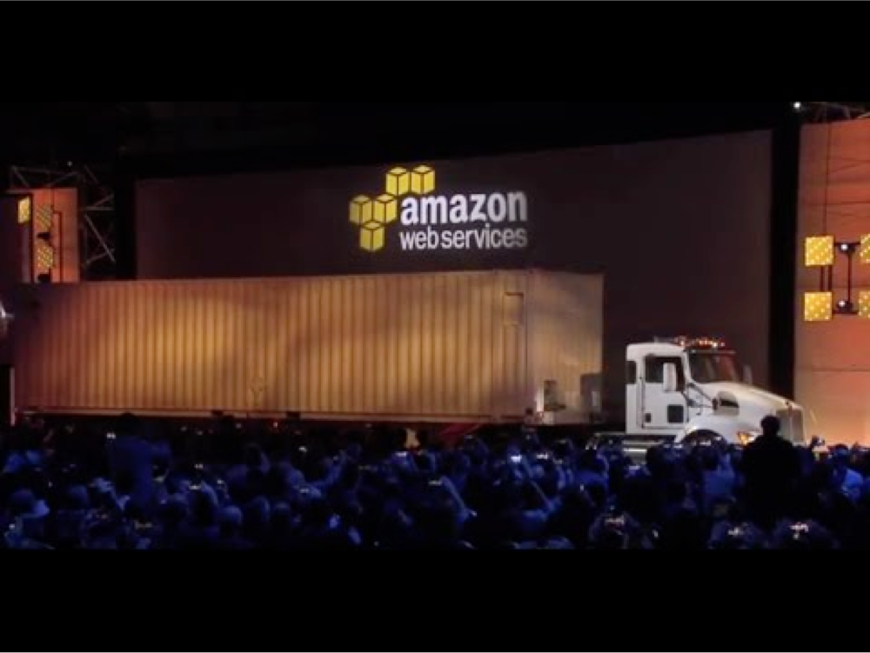
AWS Snowmobile
NOT FOR DISTRIBUTION © Stephane Maarek www.datacumulus.com
Transfer exabytes of data (1 EB = 1,000 PB = 1,000,000 TBs)
Each Snowmobile has 100 PB of capacity (use multiple in parallel)
Better than Snowball if you transfer more than 10 PB
© Stephane Maarek

Slide 247
Hybrid Cloud for Storage
NOT FOR DISTRIBUTION © Stephane Maarek www.datacumulus.com
AWS is pushing for ”hybrid cloud”
Part of your infrastructure is on the cloud
Part of your infrastructure is on-premise
This can be due to
Long cloud migrations
Security requirements
Compliance requirements
IT strategy
S3 is a proprietary storage technology (unlike EFS / NFS), so how do you expose the S3 data on-premise?
AWS Storage Gateway!
© Stephane Maarek

Slide 248





AWS Storage Cloud Native Options
NOT FOR DISTRIBUTION © Stephane Maarek www.datacumulus.com
BLOCK
FILE
Amazon EFS
OBJECT
Amazon EBS
EC2 Instance Store
S3
Glacier
© Stephane Maarek

Slide 249







AWS Storage Gateway
NOT FOR DISTRIBUTION © Stephane Maarek www.datacumulus.com
Bridge between on-premise data and cloud data in S3
Use cases: disaster recovery, backup & restore, tiered storage
Files
Tapes
Volumes
3 types of Storage Gateway:
File Gateway
Volume Gateway
Tape Gateway
AWS Storage Gateway
Exam Tip:You need to know the differences between all 3!
Amazon EBS
S3
Glacier
© Stephane Maarek

Slide 250
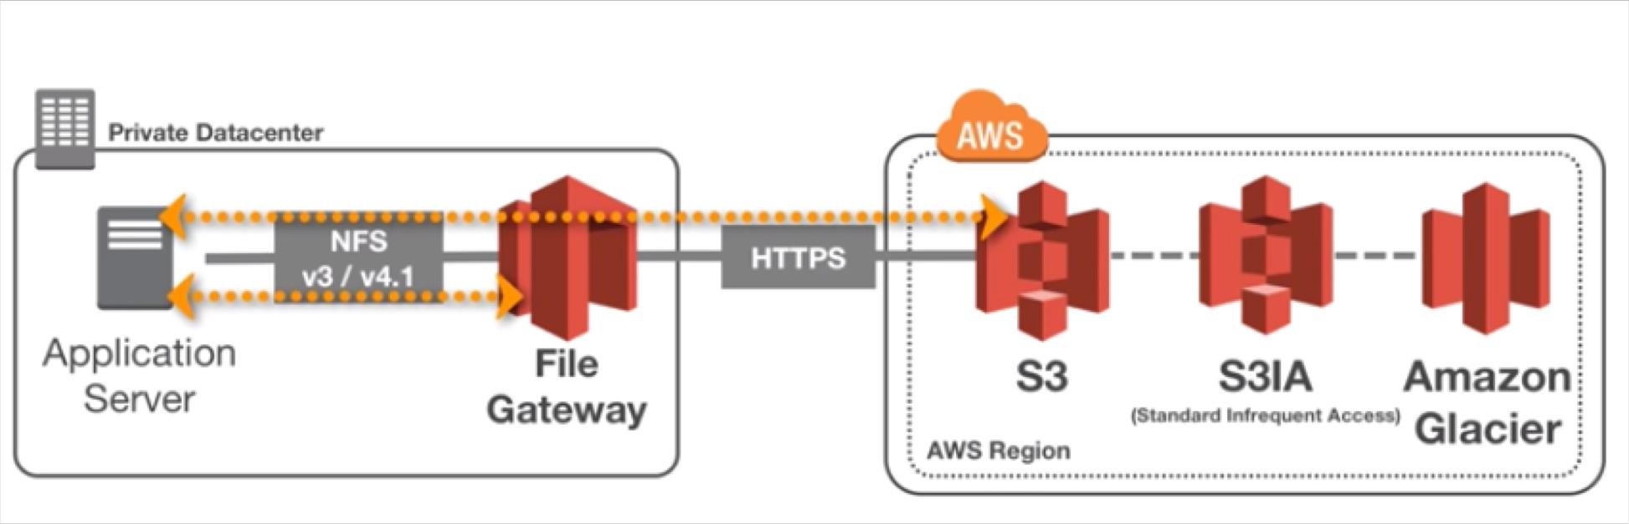
File Gateway
NOT FOR DISTRIBUTION © Stephane Maarek www.datacumulus.com
Configured S3 buckets are accessible using the NFS and SMB protocol
Supports S3 standard, S3 IA, S3 One Zone IA
Bucket access using IAM roles for each File Gateway
Most recently used data is cached in the file gateway
Can be mounted on many servers
© Stephane Maarek

